Slide 1
Buckle up, buttercup!
It’s Political Advertising Season
Jennifer A. Dukarski | Dukarski@Butzel.com

Slide 2

Why are We Here?

Slide 3
WARNING!
The content you are about to see contains factual information and the opinion of various print and broadcast companies.
The content is intended to inform and ultimately protect those member papers and journalists within the State of Michigan.
It may refer to certain states and national candidates, but the MPA General Counsel and Hotline Team are NOT advocating for any political party through this presentation.

Slide 4
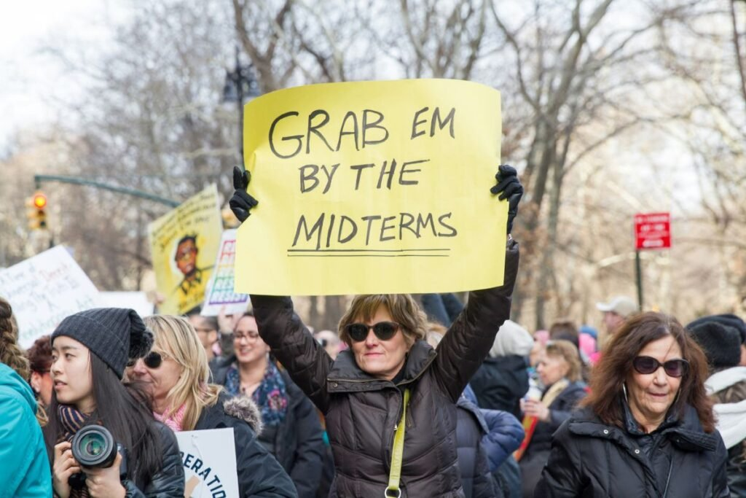
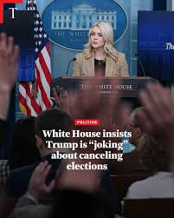
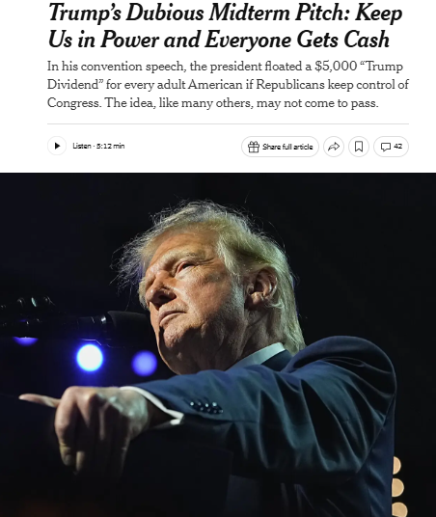
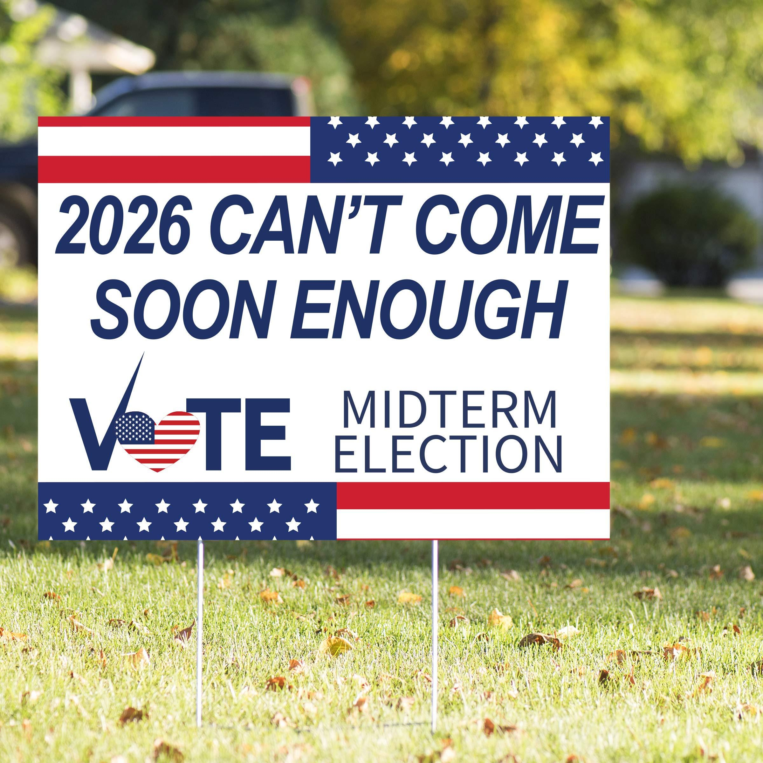
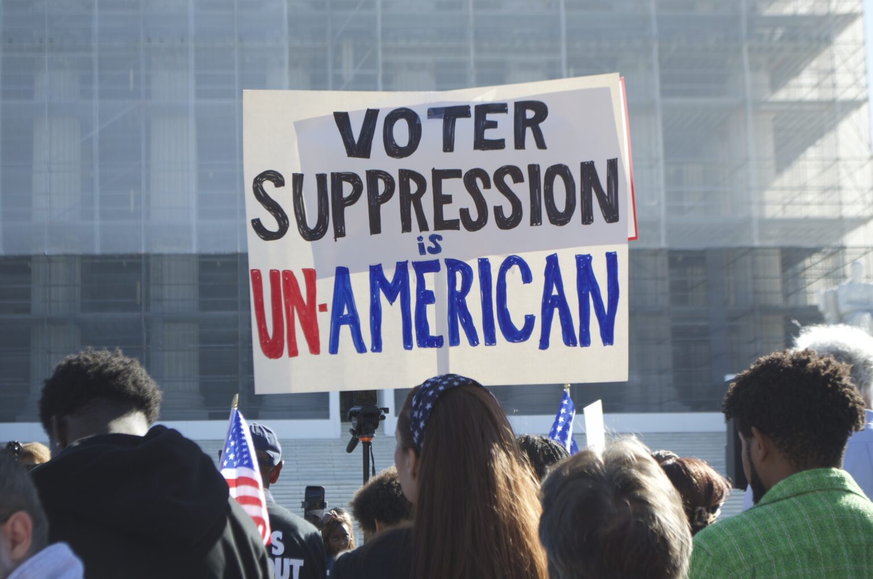
Simply put: We’re here because it could get nasty (AGAIN)

Slide 5
The Basics

Slide 6
Which body of law applies?
The body of applicable law depends on who the candidate is and what office are they running for:
  State offices → State law applies
  Federal offices (Senator, U.S. House of Representatives) → Federal law applies

Slide 7






Regulatory Bodies

Slide 8
Who Could be Liable for a Bad Ad?
Anyone from an advertising agency to a website designer may be responsible for advertising! Newspapers included! All you have to do is participate in the preparation or distribution of the advertising OR know about a deceptive claim
Therefore, you must:
  Review the information used to support ad claims
  Not rely on the advertiser’s assurance that the claims are true without some level of review

Slide 9
What Can You Do if You Don’t Want to Run an Ad?
Newspapers are generally considered private enterprises, therefore they are not legally obligated to sell advertising to all
However, you must treat all would be advertisers equally, MCLS § 600. 2534: a newspaper that accepts for publication a legal or public notice as provided by law shall not charge higher rates for political notices or political advertising than it charges for commercial advertising of the same or similar size
You can deny but you can’t differentiate

Slide 10
Disclaimers

Slide 11
State Required Disclaimers
Identification: Name and Address unless not on behalf of the candidate or committee
Not Authorized: Required if paid for by another registered committee or an unregistered committee without candidate authorization
Regulated Funds:
  Not required if placed by the candidate or committee
  Not required if placed by an individual (independent expenditure)
  Required of about a candidate but is paid for by a registered committee
  Required for a ballot item placed by the ballot committee

Slide 12
Federally Required Disclaimers
Identification: Name and Address and Phone Number or Website if not authorized by a candidate, candidate’s committee, or agents
Authorized: Required if paid for by another person but authorized by a candidate, candidate’s committee, or agents
Endorsements: if the ad contains an endorsement the FTC says the endorsement must reflect the honest opinions, findings, beliefs, or experience of the endorser. Furthermore, an endorsement may not convey any express or implied representation that would be deceptive if made directly by the advertiser

Slide 13

Turn to the MPA Election Law Grid for More Answers!

Slide 14
Michigan’s new AI Law

Slide 15
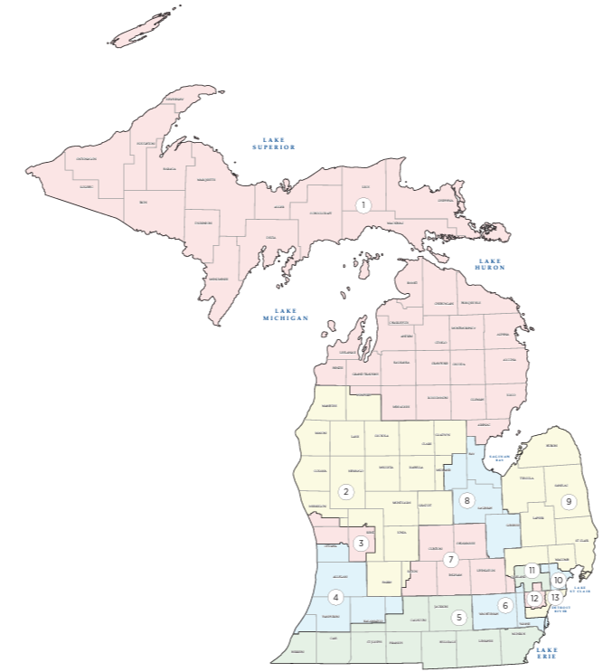
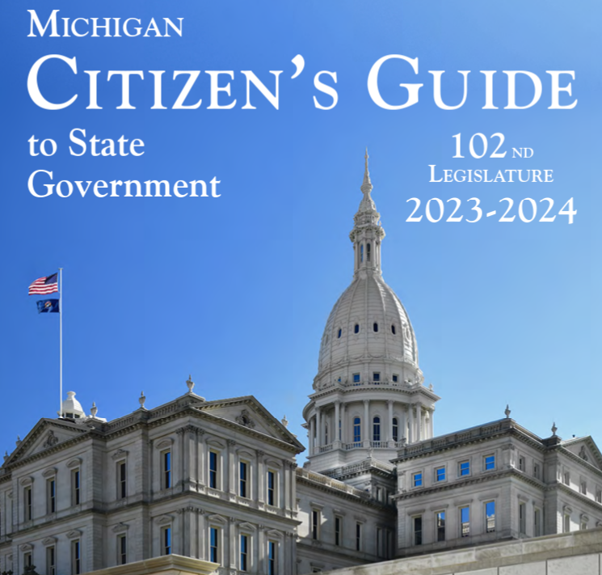
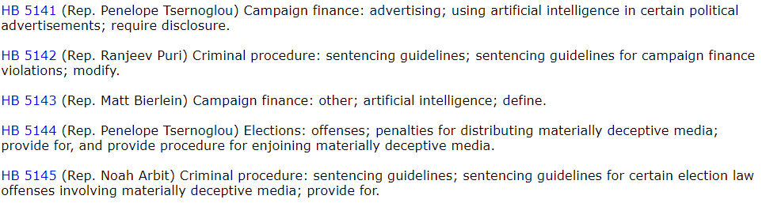
Michigan Passes AI Campaign Advertising Law
Sec. 59. (1) If a person, committee, or other entity creates, publishes, or originally distributes a qualified political advertisement, the qualified political advertisement must include, in a clear and conspicuous manner, a statement that meets all of the following requirements, as applicable:
State that the qualified political advertisement was generated in whole or in part by artificial intelligence.
If the qualified political advertisement is a text or graphic communication, appear in letters at least as large as the majority of the text in the communication.

Slide 16

Under the New AI Law
You will need to ask all advertisers (*or advertisers in the area the law covers – like political advertising) if they used GenAI to create their copy
  Note: The Legislature REALLY needs to define GenAI, because (technically) spell check applies artificial intelligence and might have to be disclosed
You will want to consider assuring you have good indemnification provisions that call out the use of artificial intelligence
You will want to have an internal AI advertising policy that you provide to your advertisers

Slide 17
Questionable Advertising – or –Can You Tell it’s a Crazy midterm Election Cycle?

Slide 18
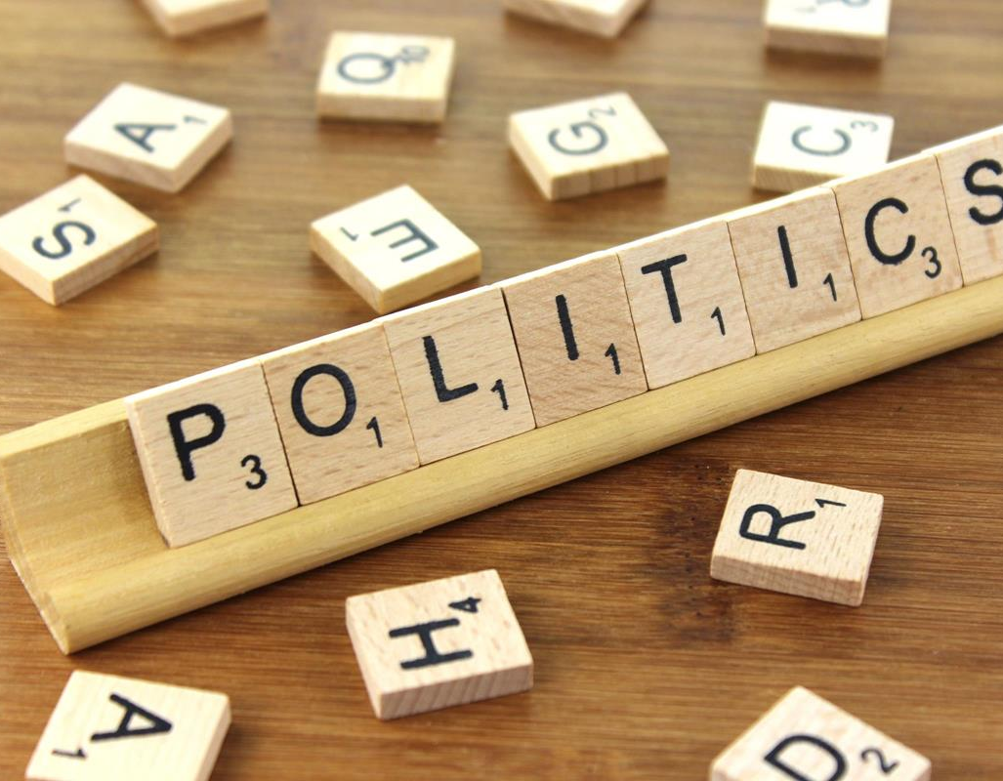
Categories Critical to Election Advertisements –
Disinformation, False Information and Misrepresentation
Definition: advertising making, publishing, or disseminating any advertisement or statement that contains untrue, deceptive, or misleading assertions regarding a product or service
Example:
  A candidate lying about former employment experiences
  A candidate accusing an opponent of having a criminal record

Slide 19
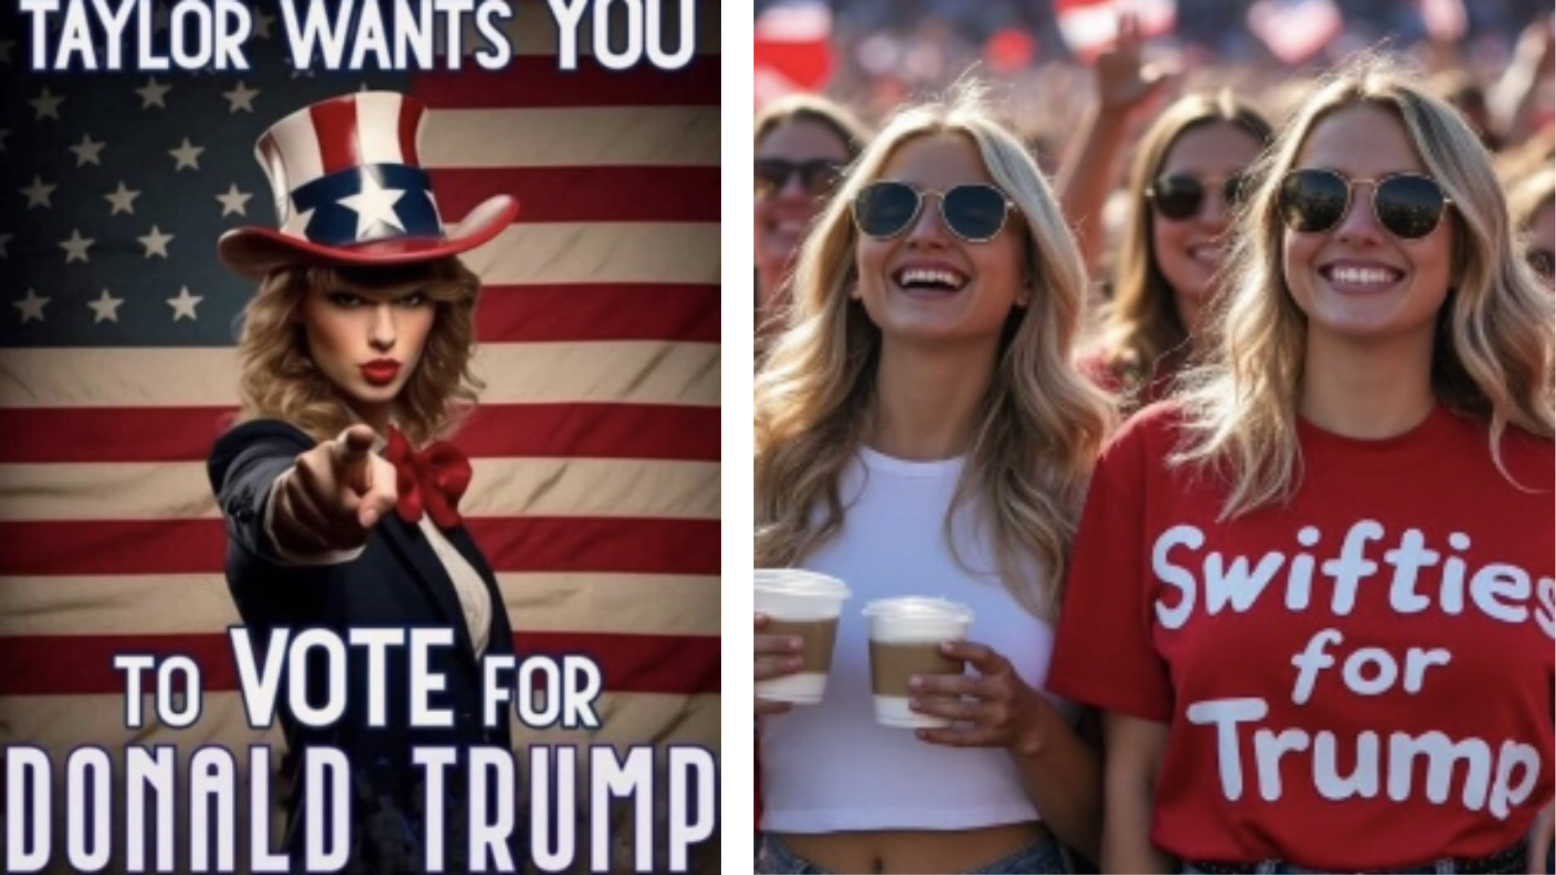
Categories Critical to Election Advertisements - Misrepresentation of Source or Quality
Definition: advertising representing goods or services as having sponsorship, approval, characteristics, ingredients, uses, benefits, or quantities that they do not have, or misrepresenting the source, sponsorship, approval, or certification of goods or services
Example:
  A candidate advertising a fictional sponsorship
  A campaign falsely claiming that an ad was approved or paid for by a certain organization
Notes:
Brief overview of the Swifties for Trump AI issue: https://www.forbes.com/sites/petersuciu/2024/08/19/trump-shared-fake-ai-taylor-swift-endorsement-it-wont-end-well/

Slide 20
Categories Critical to Election Advertisements -
Deceptive Advertising Practices
Definition: advertising representing goods or services as having sponsorship, approval, characteristics, ingredients, uses, benefits, or quantities that they do not have, or misrepresenting the source, sponsorship, approval, or certification of goods or services
Examples:
  A political flyer from a candidate falsely declaring themselves to be the incumbent when they are not
  A candidate accusing an opponent of having been convicted of desertion during Military Service without any actual knowledge of the truth

Slide 21
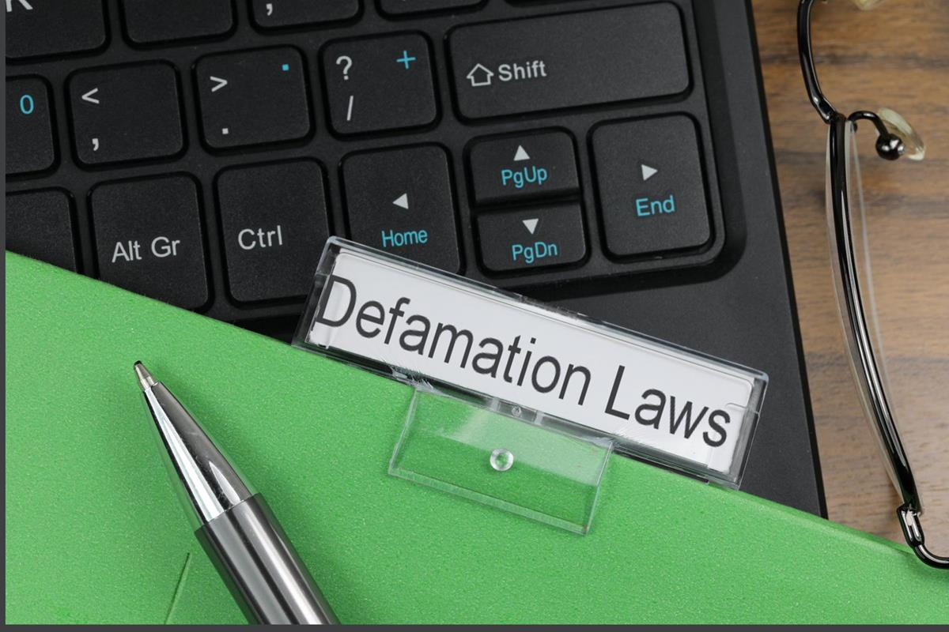
Categories Critical to Election Advertisements -
Defamation and Disparagement
Definition: advertising that offends public policy or causes substantial injury to consumers or competition in the marketplace
Example:
  A candidate accuses their opponent of taking bribes
  A candidate accuses their opponent of not paying their taxes

Slide 22
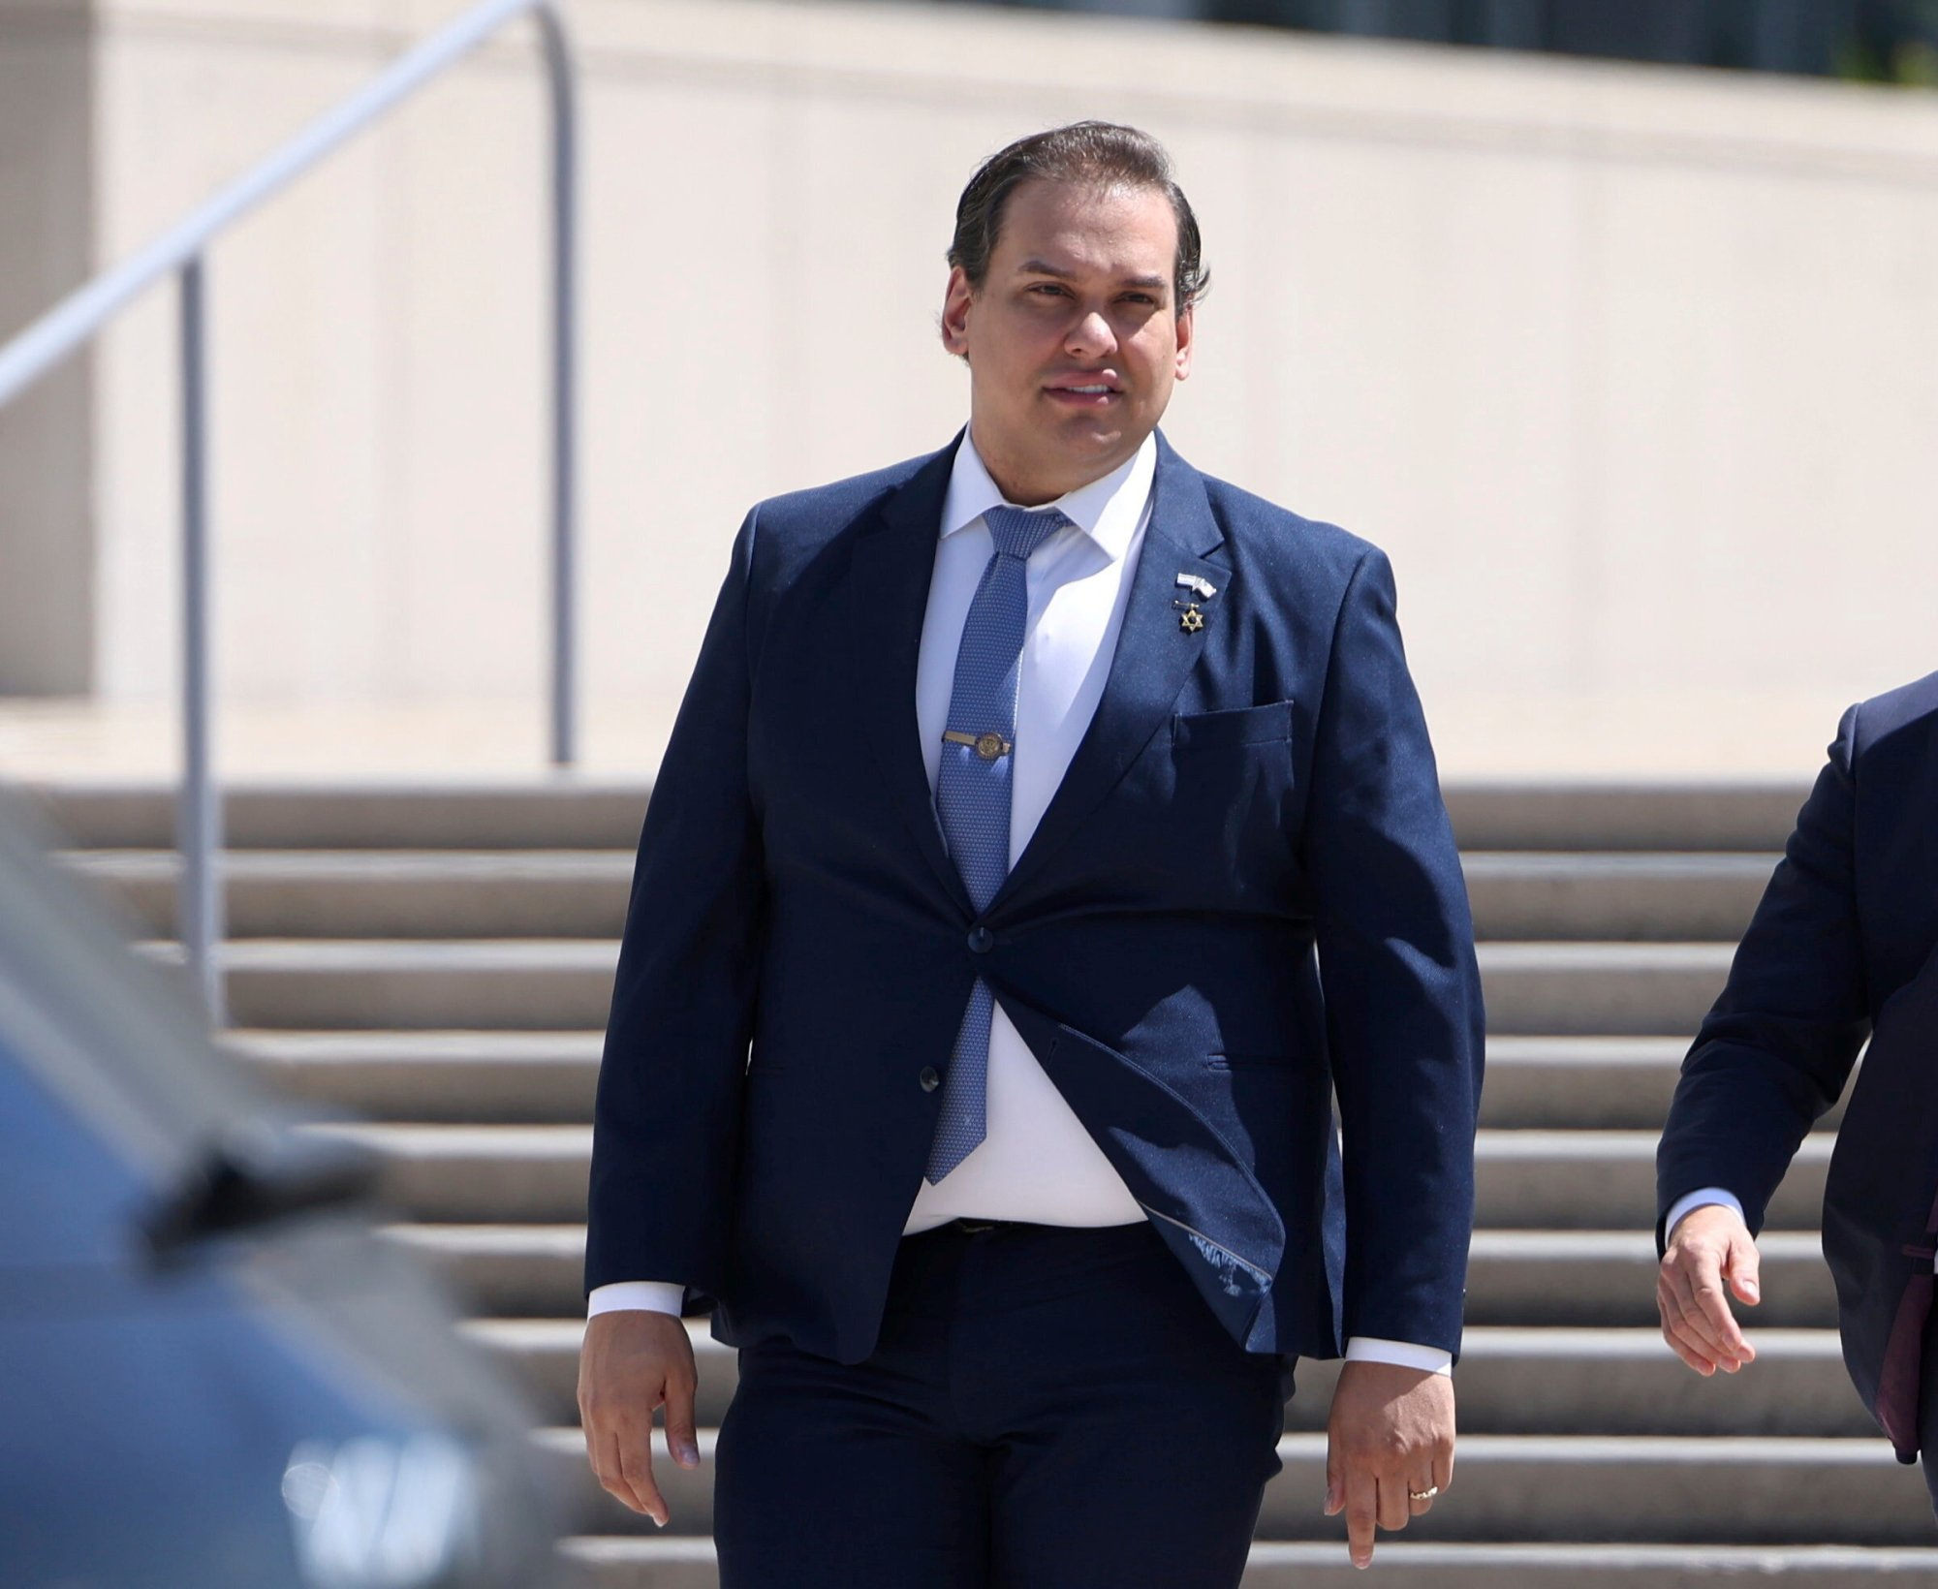
Categories Critical to Election Advertisements -
Unfair Competition
Definition: advertising including false designation of origin, false descriptions, and misrepresentations, as well as infringement of unregistered marks and false advertising
Examples:
  A candidate claiming to be someone they aren’t
  A candidate using another candidates logo or slogan
Notes:
Here’s a list of George Santo’s lies: https://nymag.com/intelligencer/article/guide-george-santos-lies.html

Slide 23
Defamation

Slide 24
What is Defamation?
Definition: the publication of a false statement that injures a person's reputation, exposes them to public hatred, contempt, ridicule, shame, or disgrace, or adversely affects their trade or business
Libel (written) v. Slander (spoken)
Per Se: statements that are inherently defamatory
  ex. accusations of a serious crime, a loathsome disease, or sexual impropriety, or where damages are presumed

Slide 25
What is Required for a Defamation Suit to Succeed?
The statement made was false, defamatory, and unprivileged
The statement concerned the Plaintiff
The statement was published to a 3rd party
The Plaintiff suffered injury or harm as a result of the statement

Slide 26
What Changes when the Parties are Public Figures?
If a case involves a public figure or matters of public concern (such as political candidates or an election), the plaintiff must also prove “actual malice”
Actual malice occurs when the defamatory statement was made with “knowledge of its falsity or with reckless disregard for the truth”
Courts weigh the harm to the reputation of the balance against the protection of free speech as a whole

Slide 27
Other Issues

Slide 28
Are They an Incumbent?
Treasurer of Committee to Elect Lostracco v. Fox: the MI Court of Appeals upheld an injunction against a candidate for misleading advertisements that falsely implied incumbency. The court found that the candidate's conduct violated MI law, and that the injunction did not violate free speech rights because knowing misrepresentations are not constitutionally protected
Home-Owners Ins. Co. v. Thomas Lowe Ventures: the Michigan Circuit Court discussed the definition of "advertising" and affirm that incumbency designations in election campaign are considered advertising

Slide 29
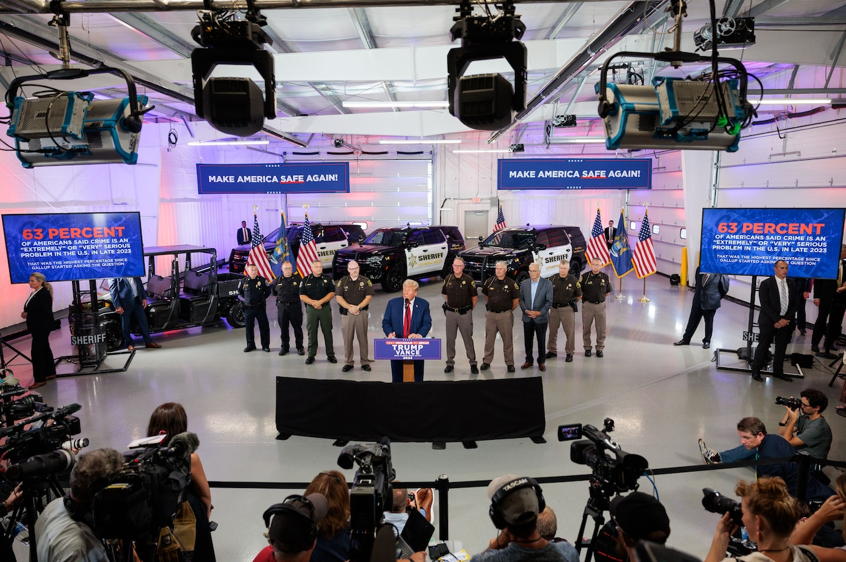
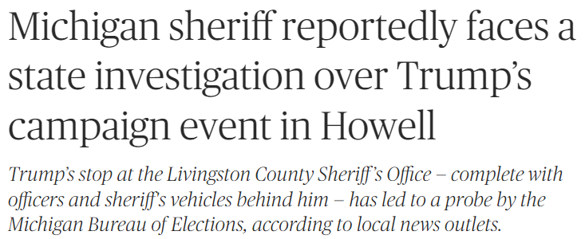
Use of Public Funds
The Michigan Campaign Finance Act forbids public officials from using public resources to support or oppose political candidates and ballot questions.
Those resources range from the use of public dollars and personnel to usage of public facilities and stationery.
The MCFA allows elected officials with policy making abilities, like a sheriff, to express their political views and take part in political demonstrations so long as public resources aren’t used.

Slide 30
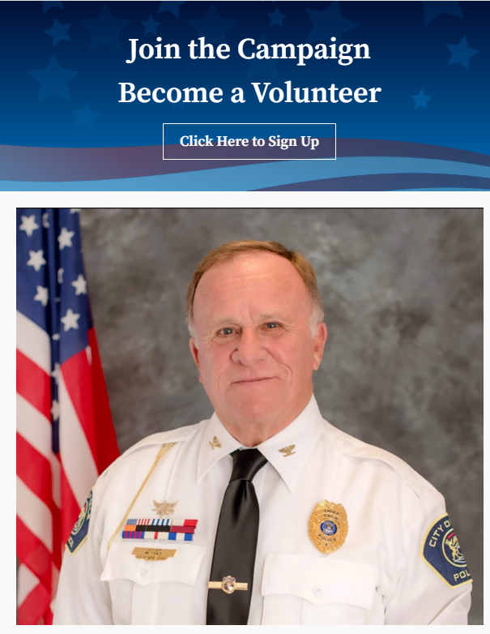
Campaigning In Uniform?
Michigan State Police issued an Official Order (02-50 on Member Political Activity):
Photographs of members in uniform and/or department vehicles shall not be used in campaign literature by members running for political office. This is not intended to discourage members from seeking political offices; however, literature containing such photographs could be misinterpreted as an endorsement of the individual by the department.
There is a risk that there is a funding violation under the Michigan Campaign Finance Act depending on the practices of the department. A public body violates the MCFA by expending its resources for prohibited campaign activity. There is a small risk in this triggering a violation if the department paid for the photograph and paid for the uniforms.

Slide 31
Tips and Tricks

Slide 32
Tips for Reviewing Ads
Does the ad have the proper disclaimer?
  Paid for…
  Who is running the ad?
Does it make any statements or assert facts?
  Sources?
  Proof?
Does it imply something potentially defamatory about the candidate?
  Past criminal or sexual history?

Slide 33
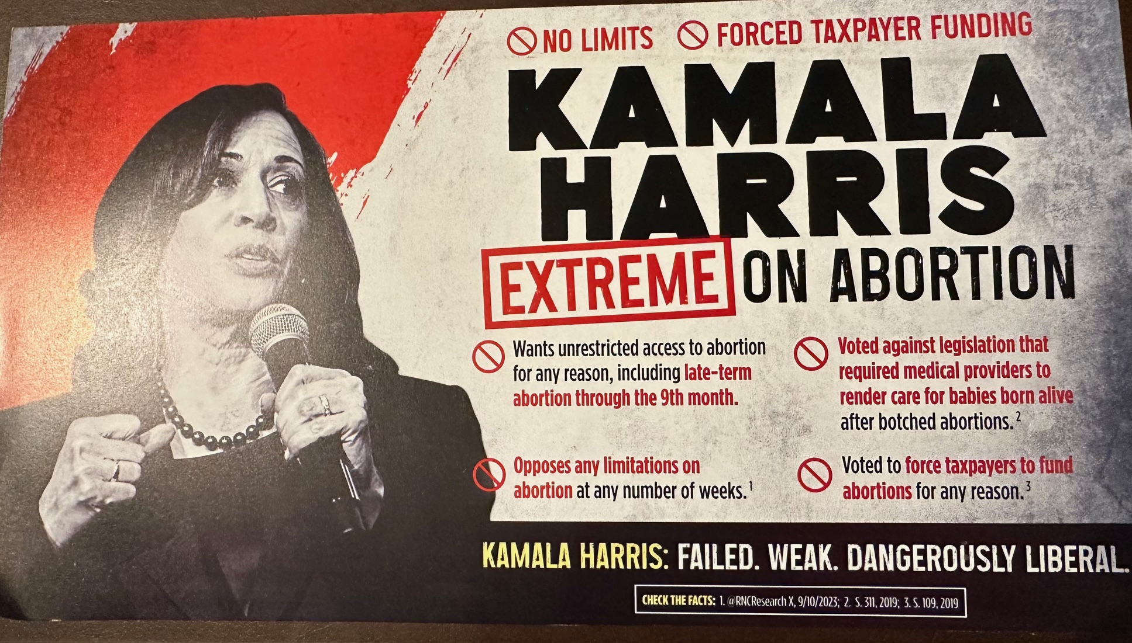
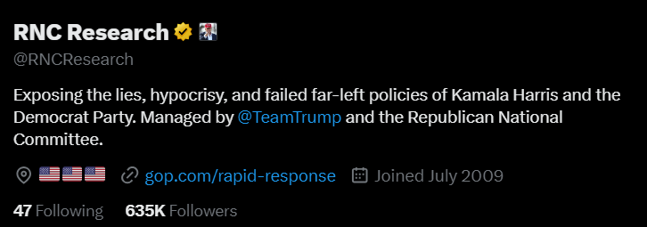
But Watch Your Fact Checking
If an ad provides you with a “fact check,” does it pass the smell test?
In a recent mailer, the campaign cites to a “research” account that is created and managed by the campaign
  Citing to its own statements without any underlying proof

Slide 34
Fact Checking: If It’s Not Gonna Happen…
The views and opinions expressed in this political advertisement are those of [ADVERTISER NAME] and do not reflect the views or positions of [PUBLICATION NAME]. [PUBLICATION NAME] has not fact checked any of the claims made and the advertisement may contain disputed claims or misinformation.

Slide 35
Actual 2024 Gems

Slide 36
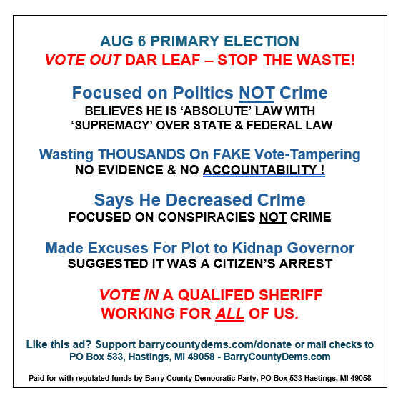
Let’s Start in Barry County…

Slide 37
Let’s Start in Barry County…
Is this true? Ask for supporting information or confirm accuracy.

Slide 38
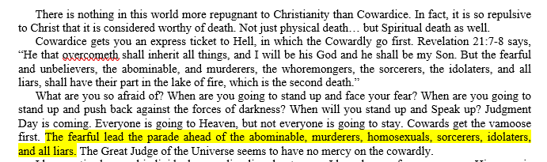
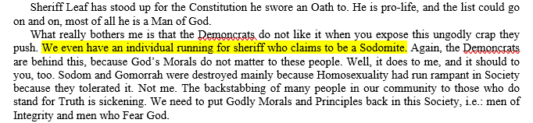
The Other Side

Slide 39
The Other Side
Do you REALLY want to run this?

Slide 40
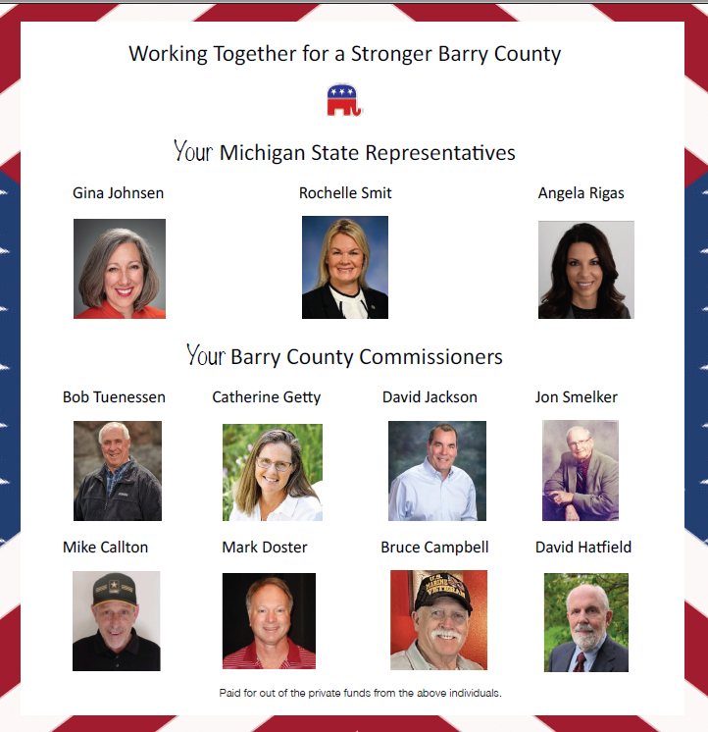
More Barry County…

Slide 41
More Barry County…
Address… yes, for ALL of them

Slide 42
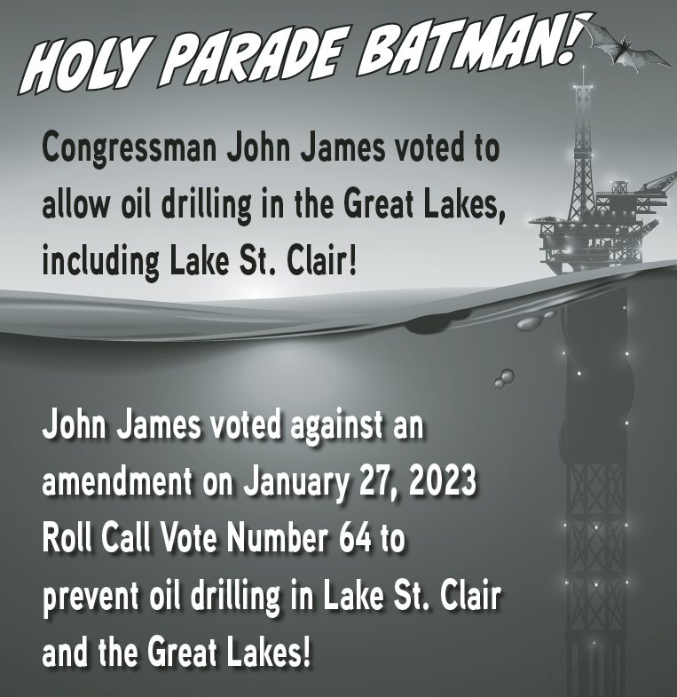
Going to the East Side

Slide 43
Going to the East Side
Holy Trademarks Batman!
Ummm… who’s running this ad??

Slide 44
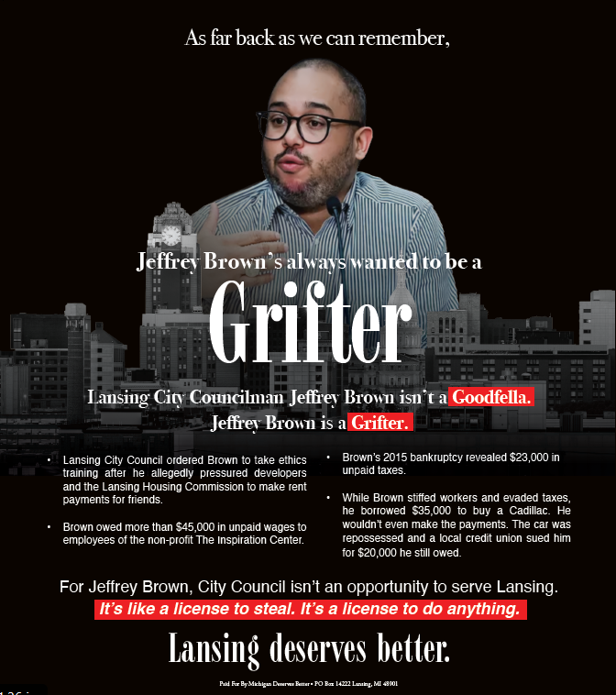
Lansing, Reporting In!

Slide 45
Lansing, Reporting In!
This is saying he’s “Crime-ing” but even the bullets below don’t necessarily support this proposition

Slide 46
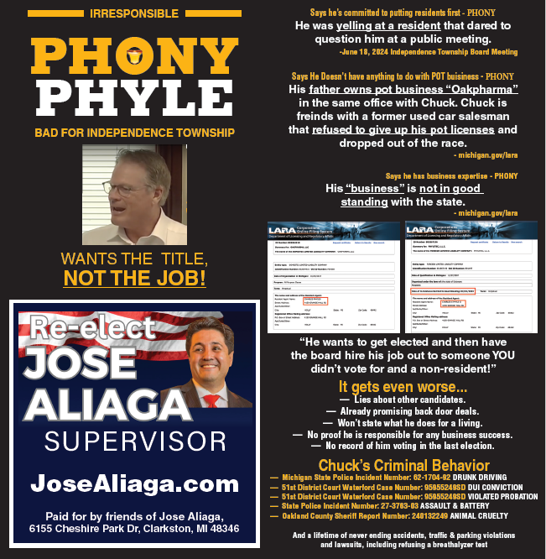
Independence Township

Slide 47
Independence Township
“Daddy Issues” aren’t the candidate’s responsibility
Wait, who owns this business?
To quote Inigo Montoya: “I do not think this means what you think it means”

Slide 48
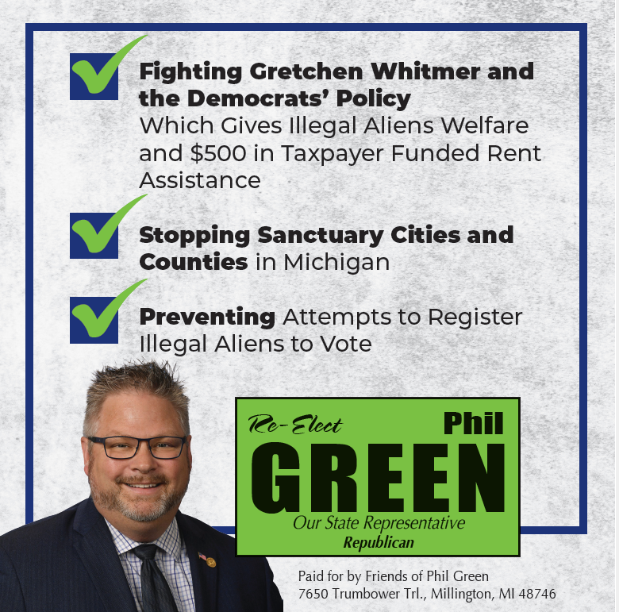
And From Millington

Slide 49
And From Millington
You have to register for political or religious asylum in the US to be eligible for this. Registering makes you “NOT ILLEGAL.” This is a bad set of talking points.
This has been WIDELY debunked, again, just talking points.

Slide 50
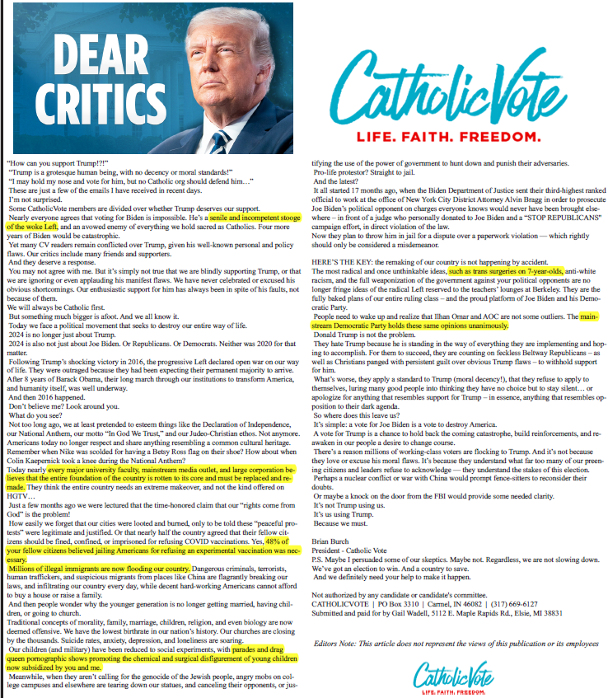


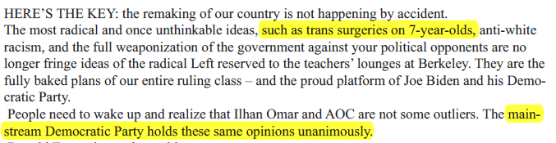
The Primary Season’s Most Interesting Ad

Slide 51
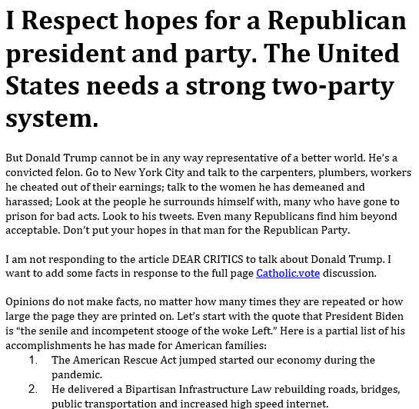
A Response to the Most Interesting Ad
You need to do the verification, but here – these are actually based on factual statements when you dig. But ask the question, regardless of the party involved!

Slide 52
THE MPA Hotline

Slide 53

How to Reach Us
As a general rule, the Hotline can provide 15 minutes of free legal advice
Make sure you give us:
  Your Name, Contact Info and Publication
  Any Deadlines!

