Slide 1
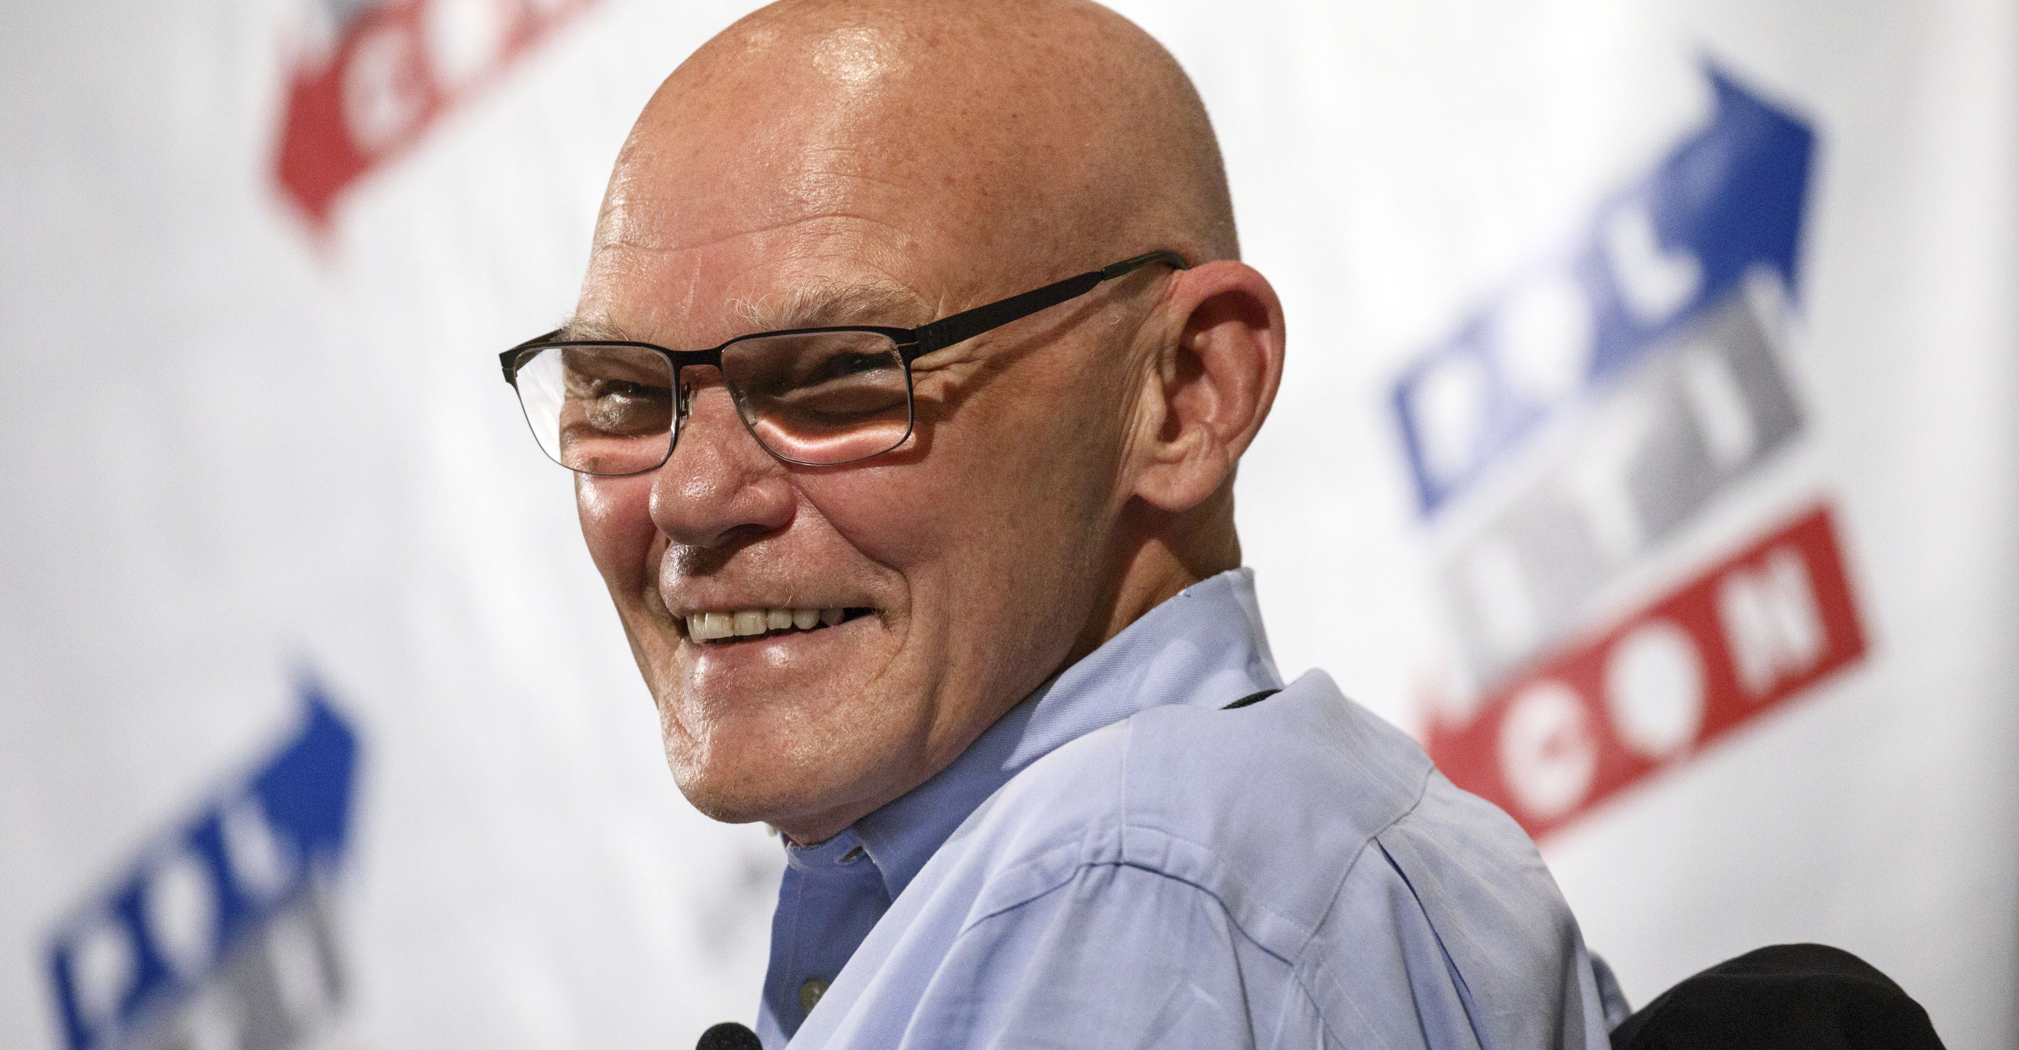
Buckle up, buttercup!
“It’s Election Coverage Season, Stupid!”
Jennifer A. Dukarski | Dukarski@Butzel.com
Joseph Richotte | Richotte@Butzel.com

Slide 2
Why are We Here?

Slide 3
WARNING!
The content you are about to see contains factual information and the opinion of various print and broadcast companies.
The content is intended to inform and ultimately protect those member papers and journalists within the State of Michigan.
It may refer to certain states and national candidates, but the MPA General Counsel and Hotline Team are NOT advocating for any political party through this presentation.

Slide 4
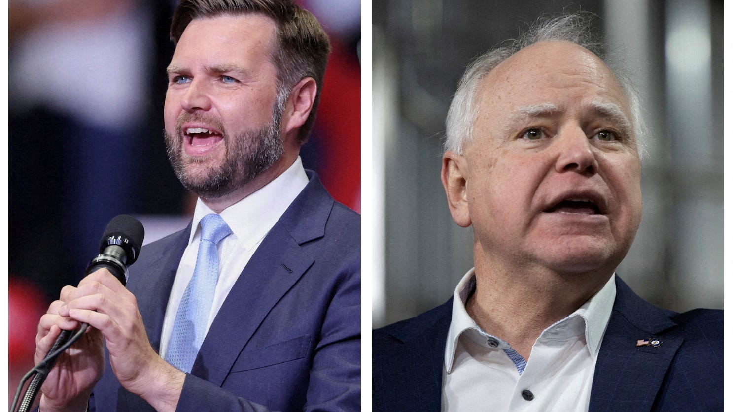
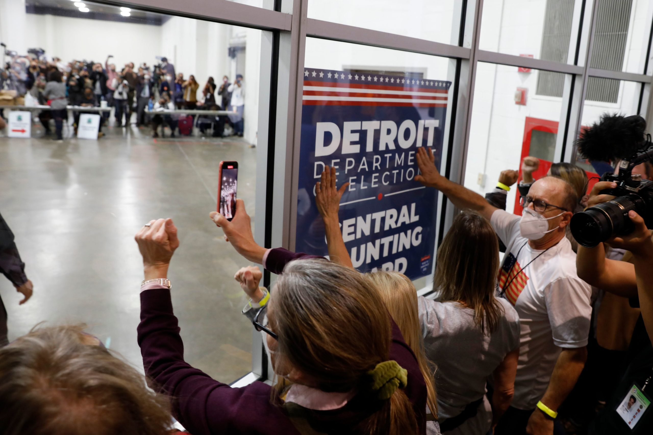
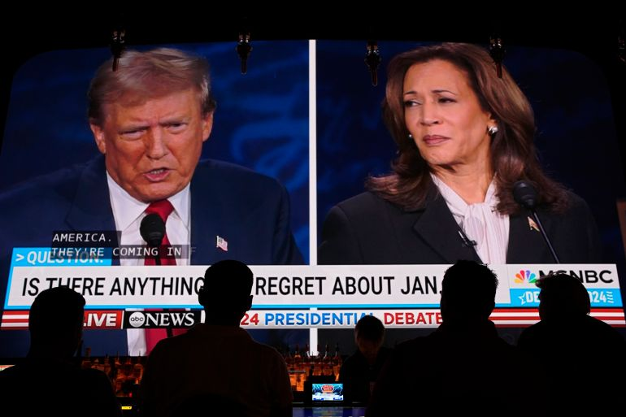
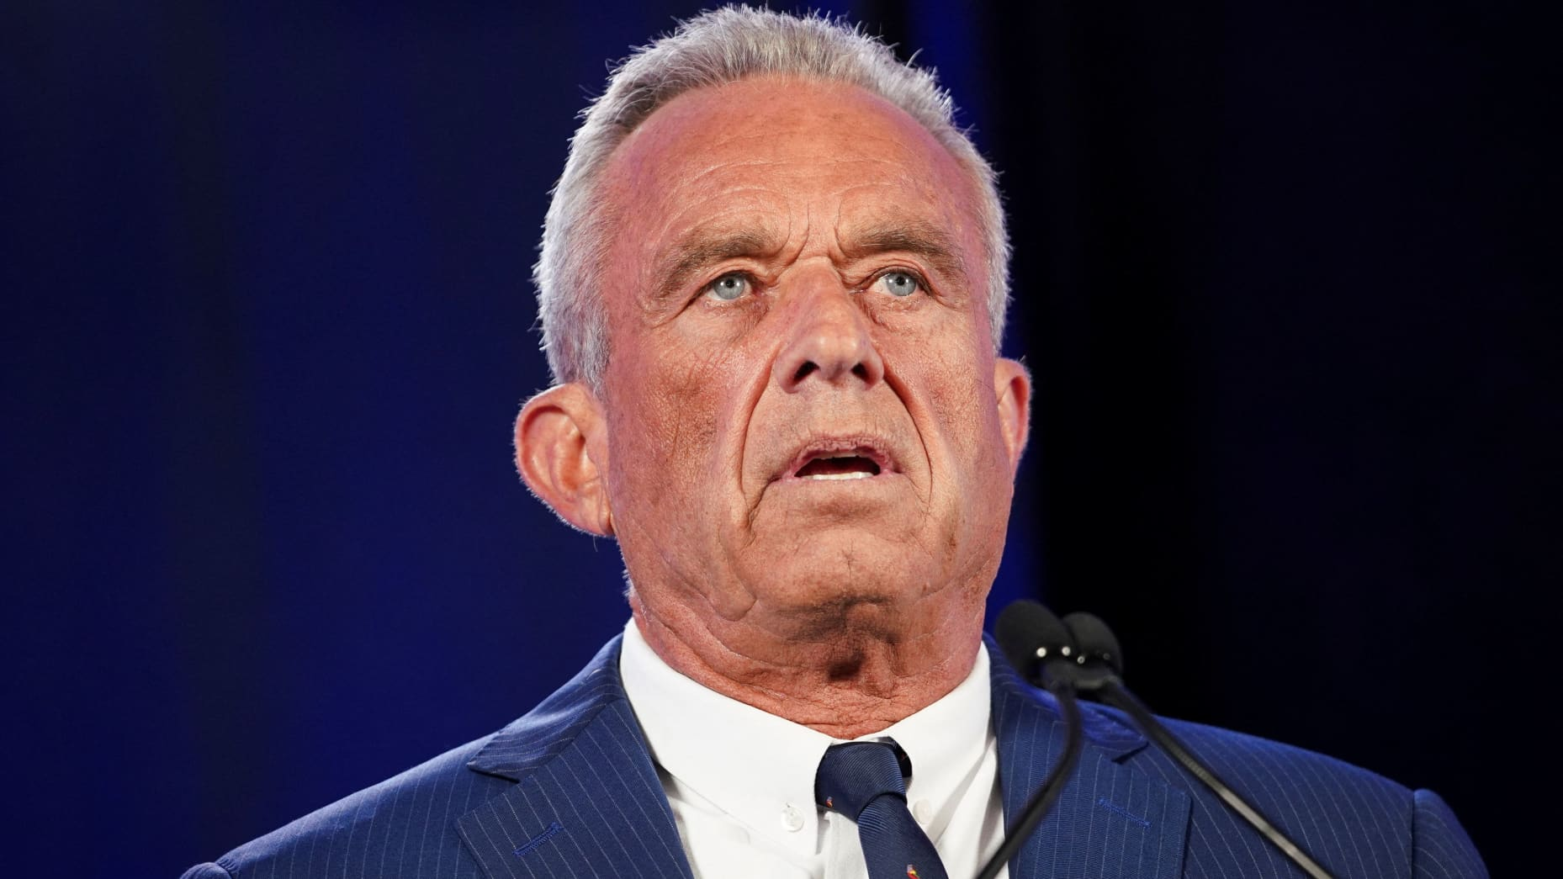
Simply put: We’re here because it could get nasty

Slide 5
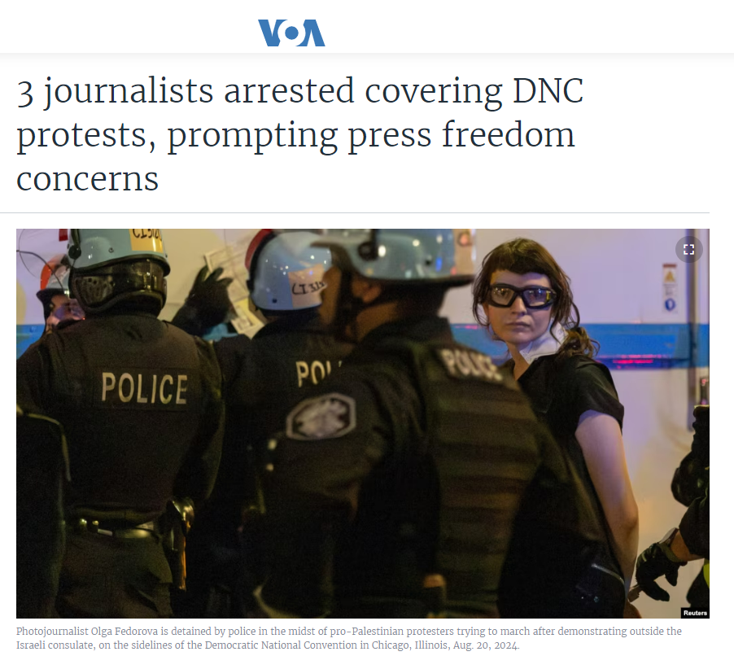

Slide 6
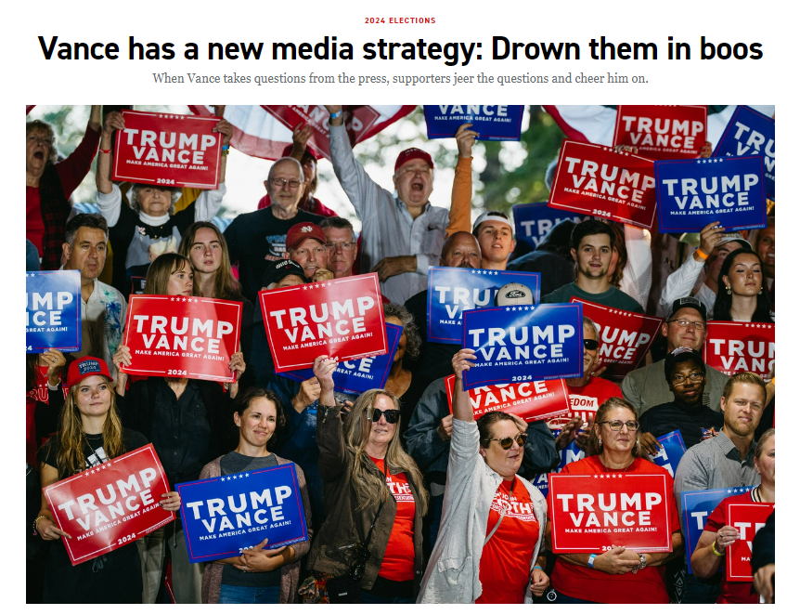
From a Politico article:
Inside an open-air barn at the Northwest Michigan Fairgrounds, Vance, who favors questions from local reporters before national ones at his events, called on the Traverse City Record-Eagle reporter, who identified himself as the “hometown” scribe.
Before he even got his question out — a relatively anodyne one about housing costs — the reporter endured a hail of boos as the Republican vice presidential nominee smiled.

Slide 7
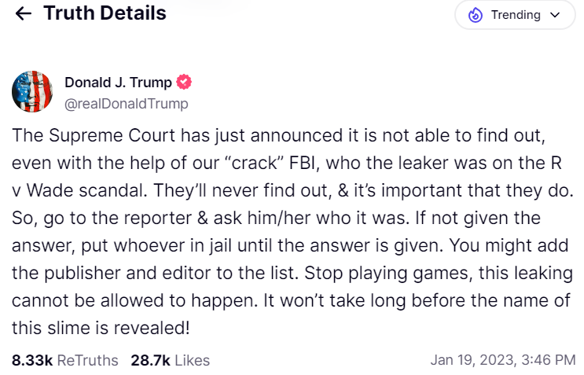
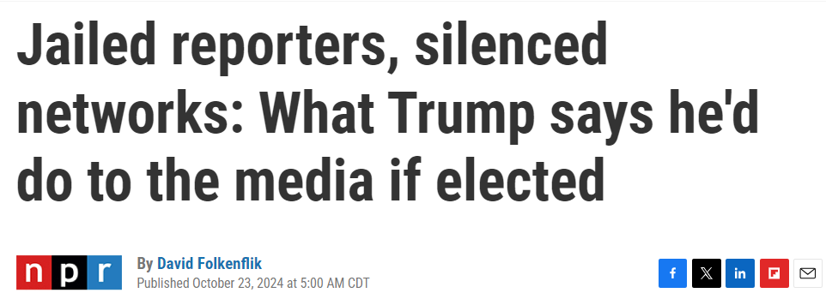
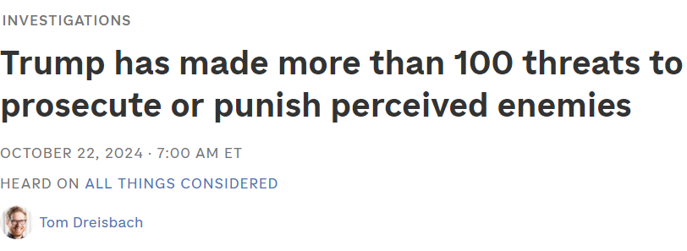

Slide 8
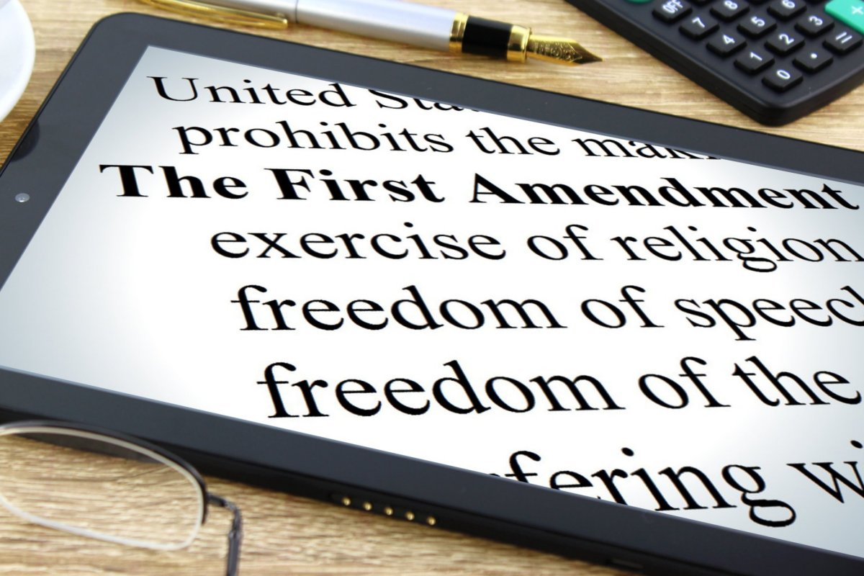

Slide 9
Rules at Polling Places

Slide 10
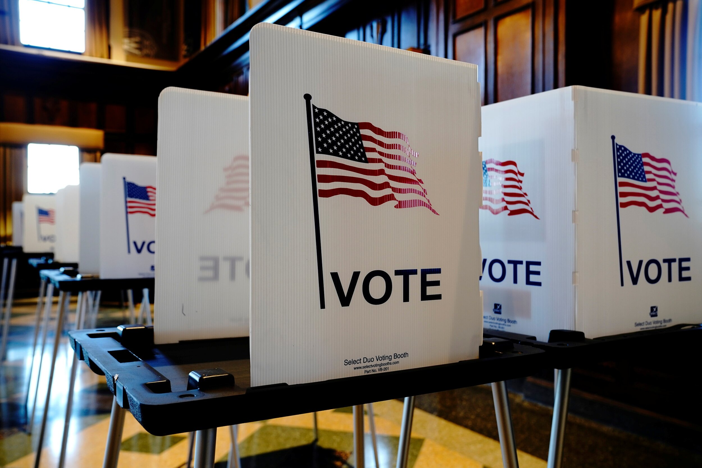
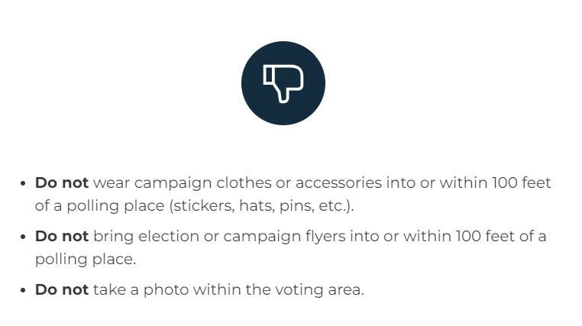
Poll Etiquette
This Photo by Unknown Author is licensed under CC BY-NC-ND

Slide 11
New Things in Michigan Election Law
Michigan now has in-person early voting. Each jurisdiction (city/township) must offer at least nine days of early voting, starting the second Saturday before the election.
Military and overseas voters who have their absentee ballots postmarked on or before Election Day count if they arrive to their local clerk’s office within six days after the election.
Young Michiganders can apply to pre-register beginning at age 16. Michiganders 17.5 and above can register to vote.
If there is an issue with absentee voter applications or absentee ballots voters have time to cure (fix) the deficiency. For an application, voters have by Monday before Election Day. For a ballot, voters have three days after the Election Day.
Clerks in jurisdictions of more than 5,000 people may process absentee ballots beginning eight days before the Election Day.

Slide 12
What you May Observe: Facts about Voting
Voters may see election workers “duplicating” some ballots — transferring the votes from one ballot to a replacement ballot. This is a normal procedure that is followed on Election Day if a ballot is damaged by the tabulator or doesn’t scan properly. This ballot is replaced by another ballot with the same votes, and only the replacement ballot is counted. This ensures a voter’s ballot will count.
If tabulators go down, voting does not stop. Ballots are placed in the auxiliary bins and scanned when the tabulators are working again.
Precincts should never run out of ballots if the local jurisdictions have ordered a sufficient number. If a precinct does run out of ballots, voters can use the Voter Assist Terminal (VAT), which print a paper ballot that can be scanned through tabulators. Precincts can also take a blank ballot and make copies or use extra AV ballots.

Slide 13
What Happens After the Polls Close?
At polling places, all voters in line by 8 p.m. must be allowed to vote. At clerks’ offices, voters in line to register to vote must be allowed to register and cast absent voter ballots
Absentee ballots cast that day at clerks’ offices are brought to polling places or absent voter counting boards for tabulation. This includes ballots cast by voters in line at 8 p.m. to register and vote on Election Day, so the ballots might not arrive until well after 8 p.m.
Election inspectors must close down the polling place properly to ensure votes have been tabulated and recorded properly and to ensure records are preserved if necessary for recounts. This includes taking ballots out of tabulators and placing them into ballot boxes/secure containers.
Once election workers confirm the tabulator ballot count agrees with the pollbook ballot count (or any discrepancies are noted and explained), precincts report unofficial results to counties. County websites will have results first. The Secretary of State website is updated only when counties submit their results to the state and won’t have the most up-to-date election results.
All results reported on Election Night are unofficial. In the two weeks following the election, a county canvass determines the officials result for each county, and a week after that the state Board of Canvassers makes results official statewide.

Slide 14
What Can Reporters Do Under The Law?

Slide 15
Can I Conduct Exit Polling?
Yes, the First Amendment protects journalists’ right to gather news outside polling places for the purpose of reporting on early election results. Courts have invalidated state-based legislation that is aimed at preventing exit polling.
There may be restrictions, however:
The US Supreme Court has made it clear that the 100-foot restriction for electioneering is reasonable. So, you may want to watch where you’re conducting the exit polling

Slide 16
Can I Report the News Near Polling Places?
Only a few courts have dealt with newsgathering near the polls. In analyzing a Pennsylvania law, the Third Circuit held that there is no First Amendment right of access to polling locations for newsgathering… but…
Our own Sixth Circuit held that Ohio was required to permit a news organization “to have reasonable access to any polling place for the purpose of news-gathering and reporting so long as [they] do not interfere with poll workers and voters as voters exercise their right to vote.”

Slide 17
Can I Take Photos Near Polling Places?
Courts have upheld the right to photography but… there are allowable restrictions inside polling location given the need to maintain ballot secrecy and an ordering voting process
Florida: photographers have been ejected from polling places
California: laws prohibit photos and videos inside polling places
Michigan: ballot selfies are constitutional and Secretary Benson allows them
In Michigan, there are ballot selfie stations at many polling locations

Slide 18
What Voter Info is Publicly Available?
Voter rolls
All voter registration records are available for public inspection during normal business hours, save preregistration records for individuals under 17 ½ years of age. Mich. Comp. Laws § 168.516.
Additional sources: Is my voter record available to the public?, Office of the Sec’y of State.
Ballots
Ballots, not traceable to individual voters, are available for inspection and copying, according to Michigan’s public records law. Mich. Comp. Laws § 15.231 et seq.
Additional sources: Office of the Mich. Att’y Gen., Op. No. 7247 (May 13, 2010).

Slide 19
What is the Count and Recount Process?
Initial counting of ballots is public. Mich. Comp. Laws § 168.801.
Candidates and voters, except candidates seeking precinct delegate positions, can request recounts. Mich. Comp. Laws §§ 168.862­–863.
Recounts are conducted in a public space where interested members of the press and public may observe the process so long as observers do not disturb those counting the ballots. Mich. Comp. Laws §§ 168.879–80; Mich. Comp. Laws § 168.889.
Individuals who intimidate an election official with the intent to interfere in the official’s duties are subject to criminal sanction. Mich. Comp. Laws § 168.931b. This provision does not apply to “constitutionally protected activity, including, but not limited to, engaging in reporting” and news gathering on “matters of public interest or public concern.”
For federal seats and State House seats contained within a single district, recount petitions must be filed within 48 hours after the Board of State Canvassers adjourns the meeting at which the determination for the seat was recorded. Mich. Comp. Laws § 168.879.

Slide 20
Recount Process
For federal and state seats contained in multiple counties, recount petitions must be filed within 48 hours after the Board of State Canvassers completes the canvass. Id.
For county seats, recount petitions must be filed within 48 hours after the Board of County Canvassers completes the canvass. Mich. Comp. Laws § 168.866.
Presidential and vice-presidential candidates “may seek judicial review of the certification or determination by a complaint for mandamus filed in the supreme court,” provided certain conditions are met. Mich. Comp. Laws § 168.845a. Review “must be filed within 48 hours after the certification or determination of the results of a presidential election.”
Voters, within 30 days after the election, may bring suit in county circuit court for apparent material fraud in an election to “decide a constitutional amendment, question, or proposition.” Mich. Comp. Laws § 600.4545.
Additional sources: Mich. Comp. Laws § 168.874; Mich. Election Dates, Office of the Mich. Sec’y of State.

Slide 21
Safety First

Slide 22
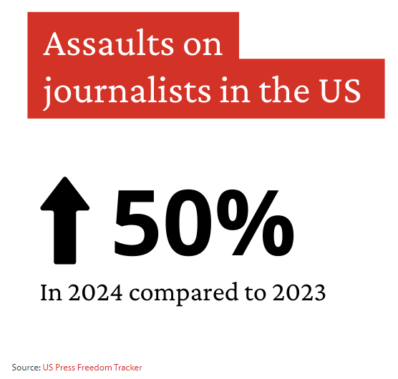
Election Coverage Safety
Our TOP priority – making sure YOU are safe!

Slide 23
Safety Checklist
Have you recorded and saved securely the emergency contact information needed in case of an event?
Does the role, gender, ethnicity, sexual orientation, or profile put you at more risk?
Do you have the appropriate accreditation, press passes, or a letter indicating your work for your organization?
Have you identified how you will communicate and remove yourself from a situation if necessary?
Have you made a plan around how to contact people if there is an internet shutdown and/or a communications blackout?
Have you planned for what happens in the event of an arrest or detention?
See generally the Committee to Protect Journalists

Slide 24
Safety Checklist – The Environment
Gauge the mood of the crowd. If possible, call other journalists already at the event to assess the mood. Consider going with another reporter or photographer if necessary.
At the event, report from the designated press area unless it is safe to do otherwise. Ascertain if the security or police will assist if you are in distress, and identify your exits.
If working in a crowd, plan a strategy. It is sensible to keep to the outside of the crowd. Avoid being sucked into the middle where it is hard to escape. Identify an escape route, and have an emergency meeting point if working with a team.

Slide 25
Safety Checklist: Wardrobe
Wear clothing without media company branding and remove media logos from equipment/vehicles if necessary. Wear appropriate footwear.
Wear clothing and footwear that allows you to move swiftly. Avoid loose clothing and lanyards that can be grabbed, as well as any flammable material (e.g. nylon). Avoid wearing politically affiliated colors or any colors associated with certain groups.
Maintain situational awareness at all times and limit the number of valuables you take. Is any special equipment such as body armor, respirators, or a medical kit required?

Slide 26
Safety Checklist: Your Health and Wellbeing
Do you have any health issues that could affect you during coverage?
Have you identified the local medical facilities in case of injury?
Do you have your insurance card for medical coverage?
Have you considered the possibility of long-term trauma-related stress? If the task was difficult, do not bottle up your emotions. Tell your superiors and colleagues. It is important that they are prepared and that everyone learns from each other.
Have you prepared for online abuse as a result of covering the election?

Slide 27
Safety Checklist: Your Vehicle
Park your vehicle in a secure location facing the direction of escape, or ensure you have a guaranteed mode of transport.
Are you driving yourself and, if so, is your vehicle roadworthy and appropriate?
Do not leave any equipment in vehicles, which are likely to be broken into. After dark, the criminal risk increases.

Slide 28
Safety Checklist – Your Devices
Have you taken steps to secure your devices–including locking devices with a password or PIN–as well as removing content such as documents, photos, and contact details for sensitive sources?
Review what information is on your phone or laptop. Back up and delete documents, photos, videos, and other material that contain personal information about you, your family, or your sources.
Be mindful that documents gathered while doing research for election-related stories could put you at risk should your devices be searched. Review footage from cameras and remove photos and videos that you would not want to fall into the wrong hands.
Set up your devices to remote wipe. Devices will only remote wipe if they are connected to the internet via Wi-Fi or data.

Slide 29
Safety Checklist – Your Devices (Continued)
Think about whether to use biometrics or not to unlock your phone. This can be useful if you need to gain access to your device quickly, but it also means that others are more easily able to unlock your phone by holding it up to your face or forcing your finger to unlock it.
Turn on encryption for your laptop or Android phone if possible. The latest version of iPhone comes with encryption as standard. Encrypting your devices will ensure that if your device is stolen people will be unable to access your data without the password.
Log out of and remove apps that you do not need to use when on the election trail, especially apps that contain a lot of personal information about you or your family.
Take as few devices with you as possible. If you have a spare phone it is better to travel with that and leave your personal phone at home.

Slide 30
THE MPA Hotline

Slide 31
How to Reach Us
During the election season, please call the hotline with any questions.
In the case of emergency situations or hot election situations ON ELECTION DAY, call the hotline OR you can call Jennifer Dukarski directly at (734) 417-6504

