Slide 1
MPA Webinar Series: Election Advertisements January 2024
Jennifer Dukarski Dukarski@Butzel.com
Erin Malone Malonee@butzel.com
Barrett Young Youngb@Butzel.com
James Pierce Piercej@Butzel.com

Slide 2
Election Night Fever: Michigan in the limelight

Slide 3
It’s that time again!
Pundits suggest national advertising spending could exceed $11 Billion this year
Down-ballot races are expected to be 75% of the spend according to NBC News
It’s going to be “fun.” There’s no doubt that advertising will bring some … interesting approaches and potential disinformation – here’s what’s blowing up NJ:

Slide 4
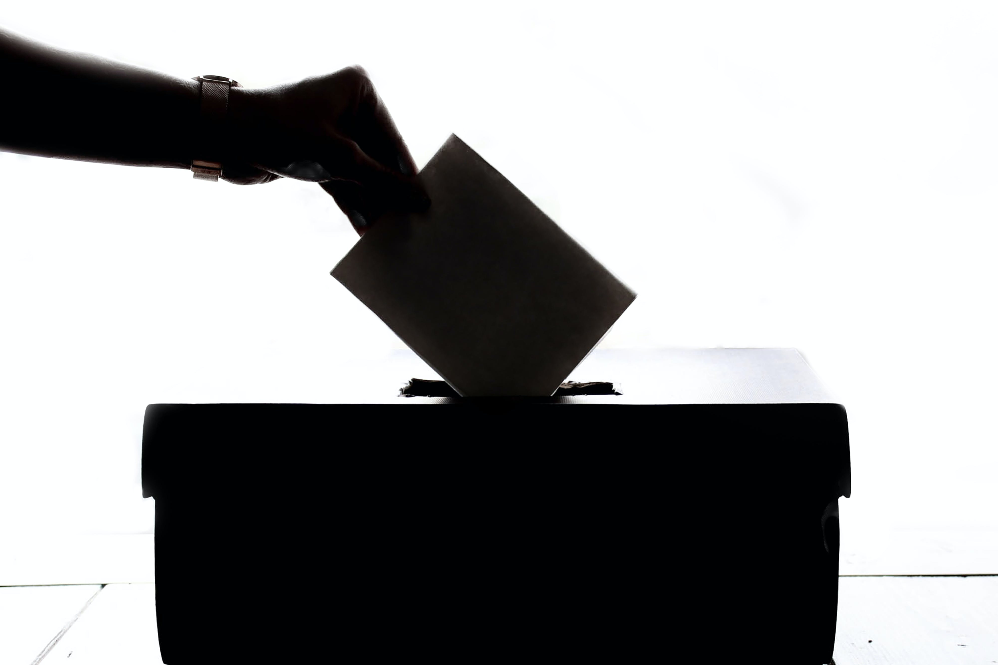
Michigan: A Nation Turns Its Lonely Eyes to You…
Michigan Plays a Looming Role in 2024: Michigan will again play a major role in both down-ballot races as well as the Presidency

Slide 5
First Principles: Don’t Forget the Normal Issues
What does the ad say?
Could the ad be defamatory?
Are the statements factually accurate?
Is there information to back up the claims being made?
This Photo by Unknown Author is licensed under CC BY-SA

Slide 6
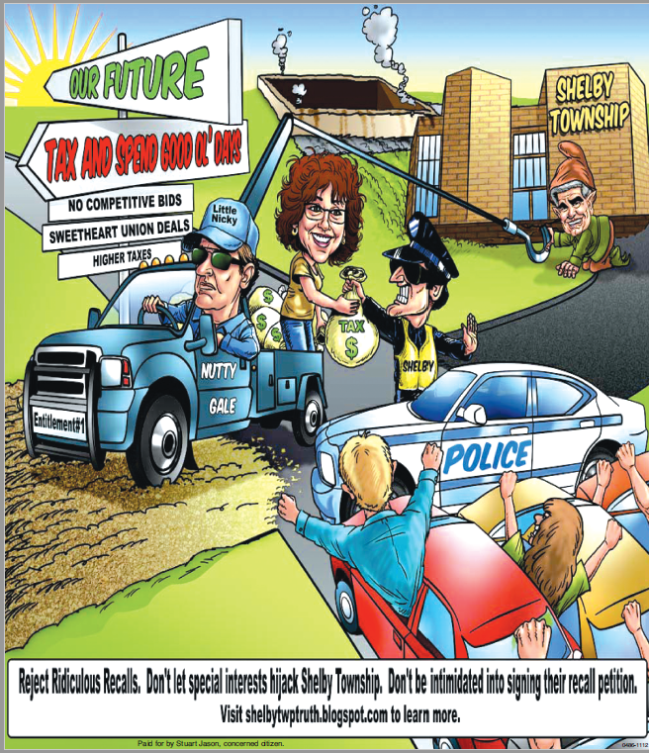
And Look Deep…
What if the ad contains a cartoon alleging misconduct by the individual running for office?
Is there some subtle undertone that only a select few may understand?
Is it a parody?
What about doctored photos (or… an advertisement with prison bars superimposed over the candidate)?

Slide 7
Preparing for disinformation and the allegations of disinformation

Slide 8
Disinformation 101
What is disinformation? According to author Barbara McQuade in the upcoming book Attack from Within, disinformation is “the deliberate use of lies to manipulate people, whether to extract a profit or to advance a political agenda.”
How does it work? Here are the tactics you may see and how they may impact you.
Aim for the Heart: Appeal to emotion over reason
Divide: Make it us against them
Demonize: Create a scapegoat or call groups a “squad” or a “gang” or… some new term
Seduce with Nostalgia: Appeal to tradition and what the community used to be
Shut down Critics: Fight the other side even using advertising – just wait for the call complaining or the desire to make ads into letters to the editor

Slide 9
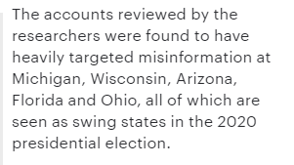
Happy Elections! Disinformation is set to return!
Nation-State Disinformation Campaigns: NYU’s Brennan Center for Justice reported on the significant 2020 election disinformation campaign that is likely to reprise itself in 2024. Top issues that are being exploited this year are:
Race
Nationalism and patriotism
Immigration
Gun control
LGBT rights

Slide 10
How to Address Disinformation
Focus on journalism and comply with traditional norms:
Use headlines that reflect the content
Double or multiple source factual assertions
Understand the risk of reliance on unnamed sources
Call out disinformation and fact check without legitimizing the falsity: provide counter-narratives or debunk without restating the claim
Don’t employ click-bait for disinformation

Slide 11
The Mechanics: Advertising requirements of MICHIGAN’s LAWs

Slide 12
Newspaper’s Own Advertisements: Author Disclaimer
If you, as a newspaper, publish an advertisement that mentions or includes anything about a candidate for Michigan public office, the advertisement must always include the author of the advertiser.

Slide 13
Requirements for Payors of Printed Political Ad: Identification Statements
Printed political ads referencing an election, candidate, or ballot question must identify …
The Name of the person/organization paying for the ad; and
The Address of the person/organization paying for the ad.
Exception: no identification statement is necessary if the payor of the ad is an individual acting independently, who is not a candidate, and is not acting as an agent for a candidate or committee.

Slide 14
Requirements for Payors of Printed Political Ad: Regulated Funds Disclaimer
When a printed political advertisement requires an identification statement, the identification statement must include the following …
“this advertisement is paid for with regulated funds”
Exceptions – this statement is not necessary if …
A candidate’s committee pays for the printed ad; OR
The printed ad does not expressly advocate the election or defeat of a “clearly identifiable candidate”
E.g., if the ad contains the following words, it will likely need the disclaimer – “vote for,” “elect,” “support,” “cast your ballot for,” “Smith for governor,” “vote against,” “defeat,” “reject,” etc.

Slide 15
Requirements for Payors of Printed Political Ad: Authorization Disclaimer Statement
Printed political ads referencing a candidate that is an independent expenditure that is not authorized in writing by the candidate committee of that candidate must include the following disclaimer…
“Not authorized by any candidate committee.”
Exception: no identification statement is necessary if the payor of the ad is an individual acting independently, who is not a candidate, and is not acting as an agent for a candidate or committee.

Slide 16
Bottom-Line for Michigan Law
Every printed political ad should contain the following:
The name of the author of the advertisement;
The name of the person or organization who is paying for the advertisement; AND
The address of the person or organization who is paying for the advertisement.

Slide 17
Michigan’s new AI Law

Slide 18
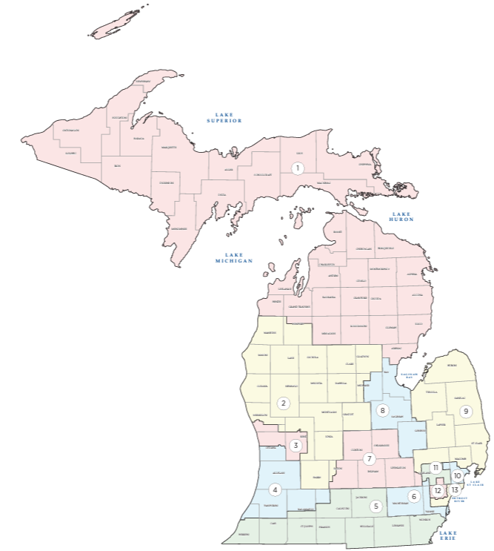
Michigan Passes AI Campaign Advertising Law
Sec. 59. (1) If a person, committee, or other entity creates, publishes, or originally distributes a qualified political advertisement, the qualified political advertisement must include, in a clear and conspicuous manner, a statement that meets all of the following requirements, as applicable:
State that the qualified political advertisement was generated in whole or in part by artificial intelligence.
If the qualified political advertisement is a text or graphic communication, appear in letters at least as large as the majority of the text in the communication.

Slide 19
Under the New AI Law
You will need to ask all advertisers (*or advertisers in the area the law covers – like political advertising) if they used GenAI to create their copy
Note: The Legislature REALLY needs to define GenAI, because (technically) spell check applies artificial intelligence and might have to be disclosed
You will want to consider assuring you have good indemnification provisions that call out the use of artificial intelligence
We have provided a sample indemnification provision behind the paywall on the MPA website.
You will want to have an internal AI advertising policy that you provide to your advertisers

Slide 20
Indemnification and AI Use Policies
For indemnification – use the MPA template AI Indemnification
[ADVERTISER/ADVERTISING AGENCY] warrants and represents that the advertisement (“Work”) and all components of the Work submitted to [NEWSPAPER] were not made in whole or in part with artificial intelligence (e.g., such as generative AI programs). [ADVERTISER/ADVERTISING AGENCY] shall indemnify, defend, and hold harmless [NEWSPAPER] from and against any losses arising from infringement or violation of any applicable laws and regulations relating to the use of artificial intelligence, including, but not limited to, intellectual property rights of third parties and privacy rights.
Use Policies – Call the hotline for a tailored AI use policy to circulate to your advertisers

Slide 21
The Mechanics: Advertising requirements of federal LAWs

Slide 22
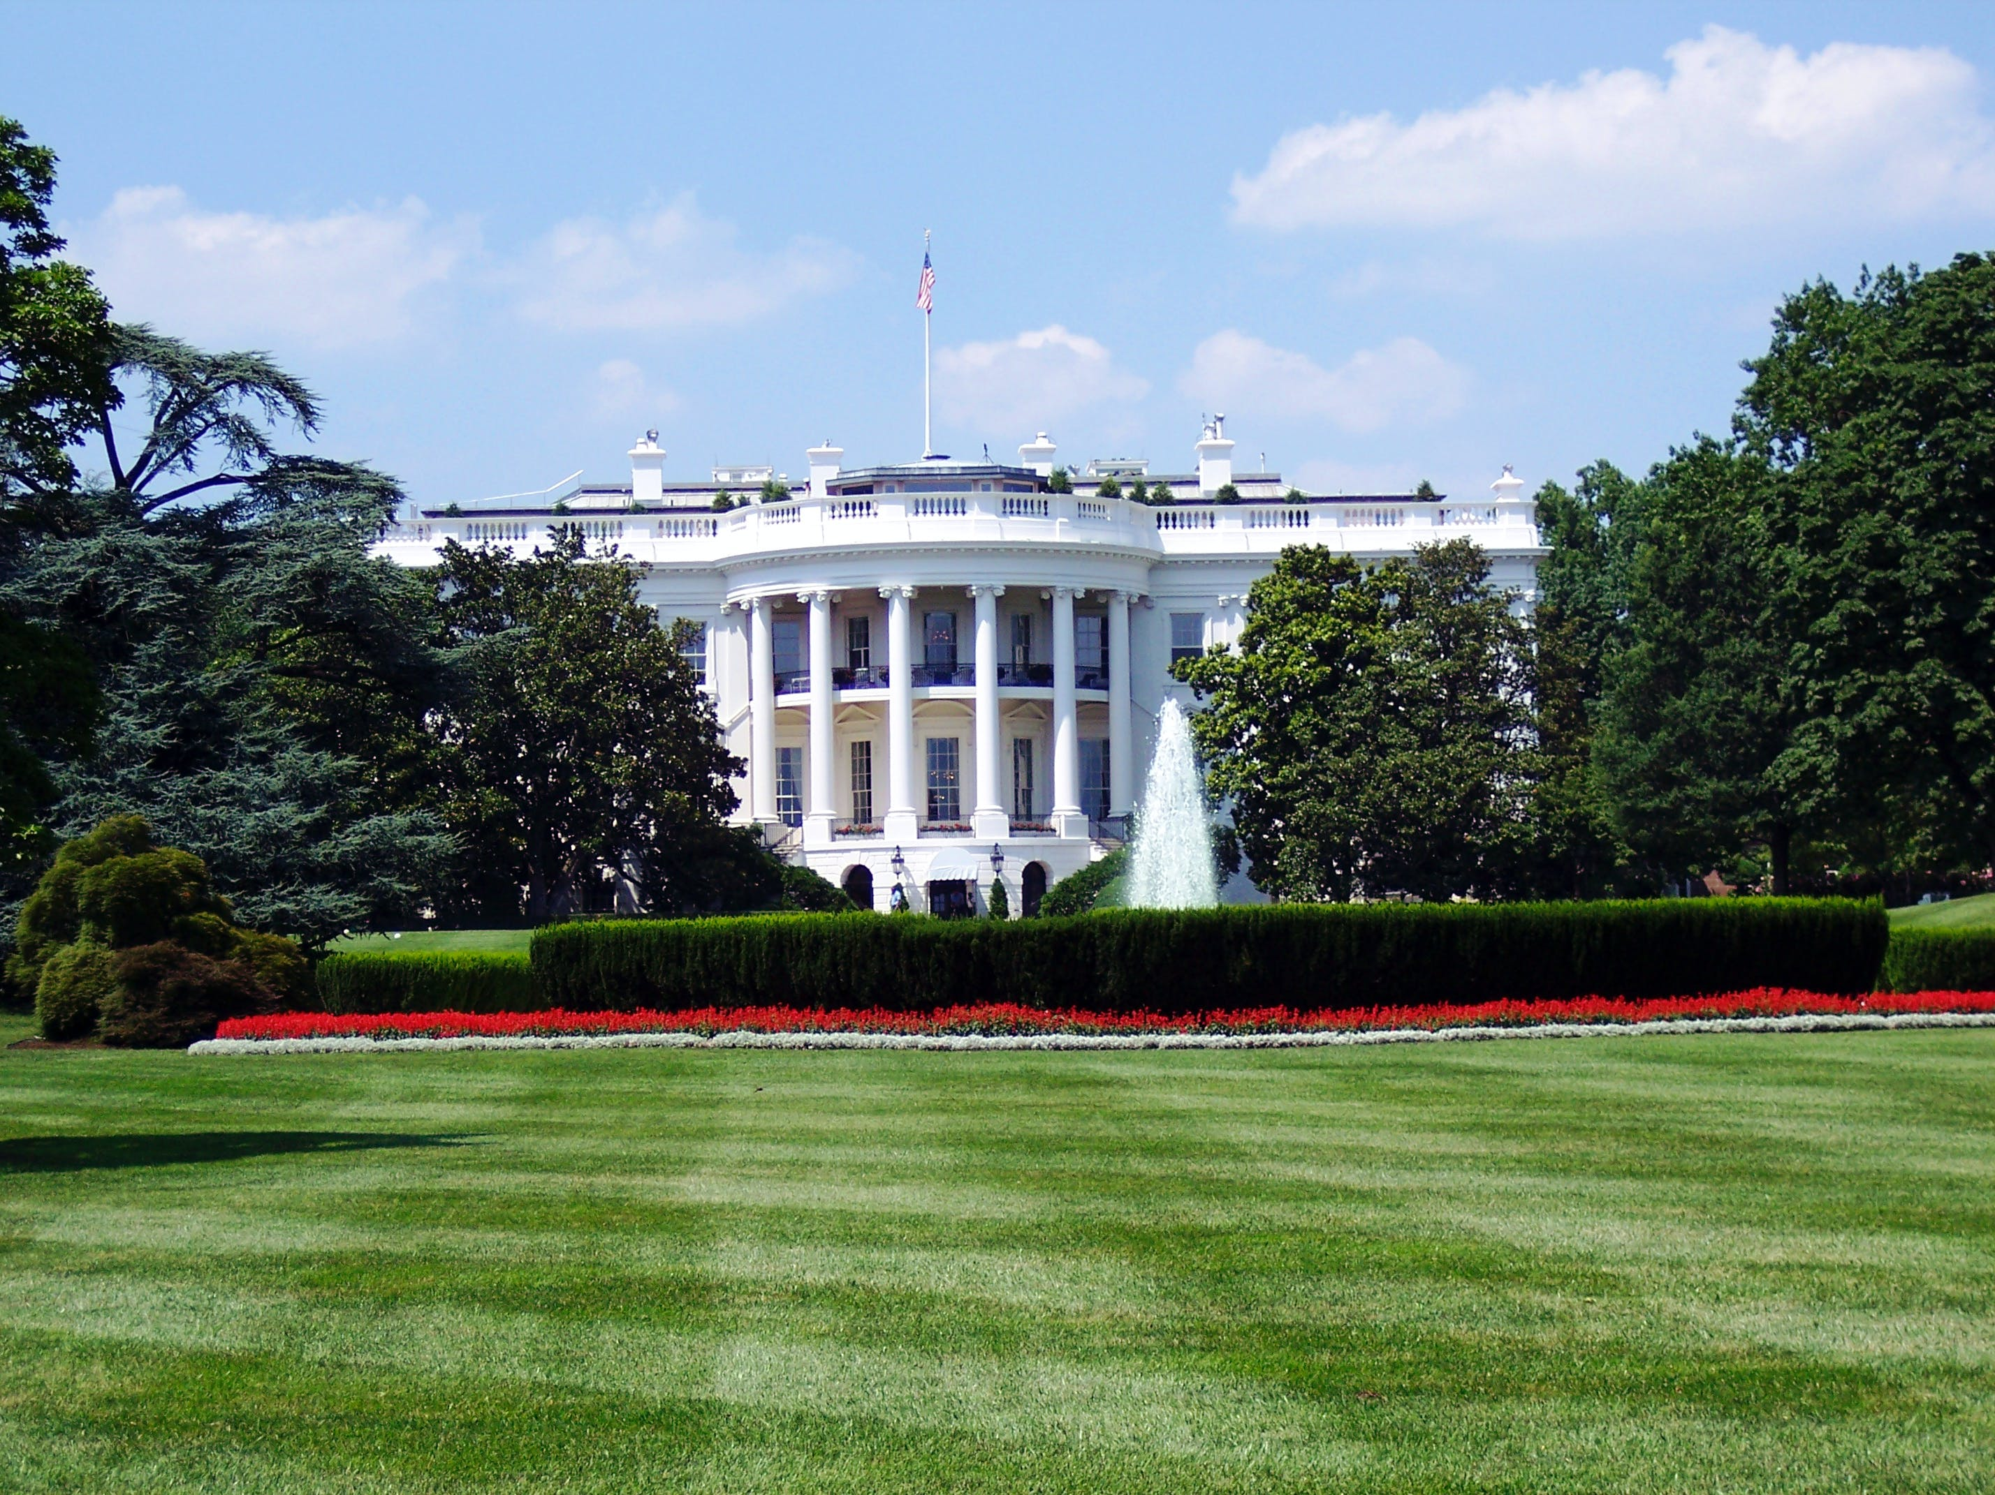
Printed Political Ad Disclaimer: When Required
Disclaimers must be included if the ad is…
Made by a political committee;
Made by any person that expressly advocates the election or defeat of a clearly identified candidate;
Made by any person that solicits any contributions; OR
Is an electioneering communication.

Slide 23
Printed Political Ad Disclaimer: Content of Disclaimer
If the printed ad is paid for or authorized by a
(1) candidate,
(2) an authorized candidate committee, or
(3) an agent of the candidate or committee,
the disclaimer must state …
“This advertisement has been [paid for/authorized] by [Smith/the committee to elect Smith]”

Slide 24
Printed Political Ad Disclaimer: Content of Disclaimer
If the printed ad is authorized by a
(1) candidate,
(2) an authorized candidate committee, or
(3) an agent of the candidate or committee,
but paid for by any other person/organization, the disclaimer must state …
“This advertisement has been [authorized] by [Smith/the committee to elect Smith] and paid for by [Lincoln]”

Slide 25
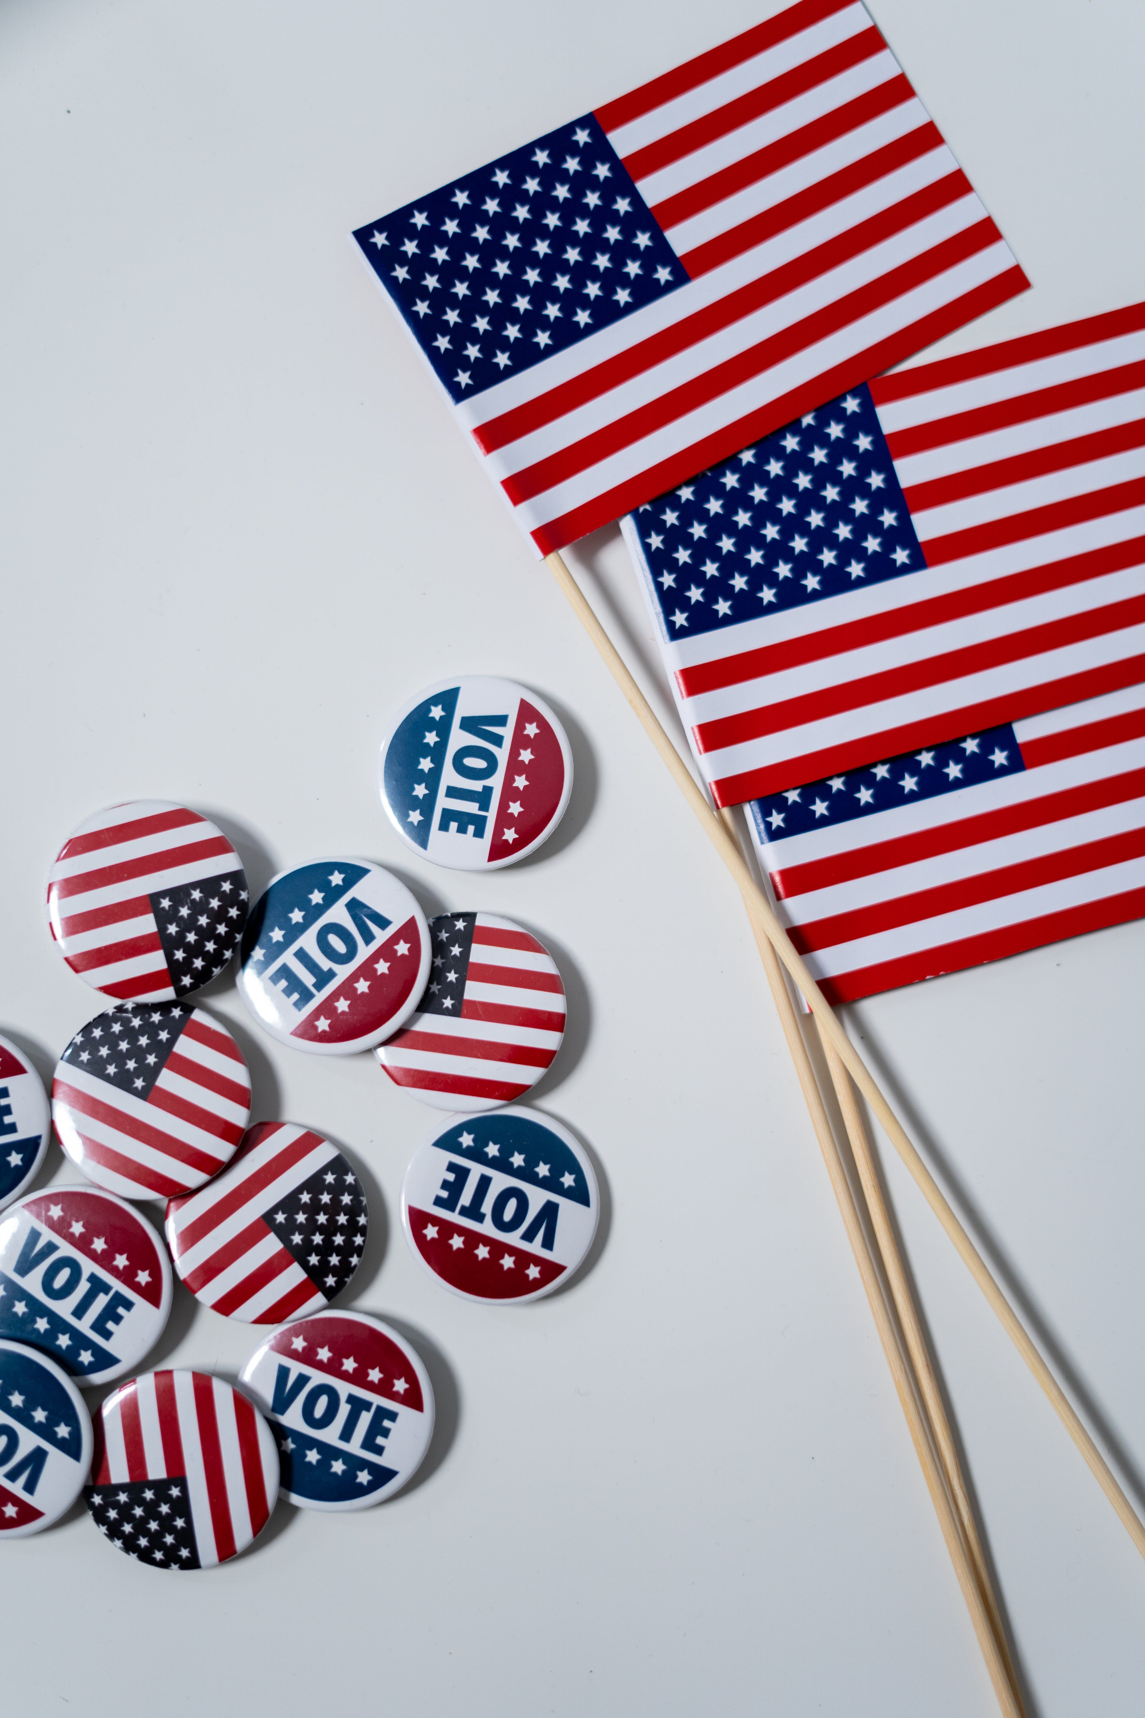
Printed Political Ad Disclaimer: Content of Disclaimer
Political Party Committee Special Rules
If the printed ad is paid for by a political party committee, then the political party committee must be named as the entity paying for the ad.
If the candidate has authorized the political party committee’s ad, this must be stated.
If the candidate has not authorized the political party committee’s ad, this must be stated.

Slide 26
Printed Political Ad Disclaimer: Content of Disclaimer
If the printed ad is not authorized by a candidate, an authorized candidate committee, or an agent of the candidate or committee, the disclaimer must state …
The Name of the person who paid for the ad;
The Address of the person who paid for the ad;
The person’s Telephone Number;
The Website Address of the person; AND
Must state – “This communication is not authorized by any candidate or candidate’s committee.”

Slide 27
Printed Political Ad Disclaimer: Presentation of Disclaimer
Make sure the disclaimers are clear, legible, and understandable!
A printed political ad must …
Be presented in a clear and conspicuous manner;
Be of sufficient type size to be clearly readable;
Be contained in a printed box set apart from the other contents of the printed advertisement; AND
Be printed with a reasonable degree of color contrast between the background and the printed statement.

Slide 28
Charging Advertisers: Keep Comparable Rates
Treat all advertisers equally!
Newspapers cannot charge a greater amount for political ads than non-political ads.
You can offer volume discounts, but the discount must be offered to all candidates.

Slide 29
Bottom-Line for Federal Law
Printed political ads should always include a disclaimer which includes
Whether the ad is authorized;
Who authorized it; AND
Who paid for it.
Disclaimers should be readable, clearly understandable, and contained in a separate box from the advertisement.
Treat all advertisers equally!

Slide 30
Other Hot Topics

Slide 31
Hot Topics in Election Advertising
Privacy: Campaigns are often getting bolder in sharing private information about candidates. Current trends include doxxing and swatting – posting private information to harass or using private information to “call down the SWAT” to someone’s residence.
Watch for questionable information about candidates in any advertising
The Impact of Social Media Restrictions: With platforms creating and using (or not enforcing) political ad policies, there may be a move to more local sources with a wider variety of divisive advertising. We’ve already seen the “squad” / “gang” competing advertisements seeking to denigrate the competition, for example.

Slide 32
Final notes on printed political ads

Slide 33
You still have editorial discretion
You do not have to publish political ads if you don’t want to!
You do not have to allow politicians to run articles on your newspaper!
You are allowed to editorially favor one candidate over another – just do not charge differing rates!

Slide 34
Confidentiality in disclaimers is generally not an issue
No law prevents the advertiser from including the name and address of the person/entity paying for the ad.
Nothing prevents the newspaper from requiring that private independent ads contain the name and address of those paying for the ad.
Still Ensure Confidentiality – Political advertisers want their ad copy to be kept confidential prior to publication. Ensure employees involved in the ad (e.g., sales and perhaps newsroom) take appropriate steps to maintain confidentiality.

Slide 35
Finally, always remember…
You are responsible for the content of any political ad you publish.
Candidates may sue the newspaper when a mistake is made.
Therefore, you must do your best to ensure the accuracy of the assertions in the ad.
If you have questions about the accuracy of the ad – call the person placing the ad and ask for sources.

Slide 36
Your Final Exam

Slide 37
WHICH OF THE FOLLOWING ARE NEWSPAPERS REQUIRED TO ACCEPT?
a. Political ads
b. Columns from politicians
c. Letters to the Editor
ANSWER: NONE!
Notes:
Newspapers do not have to accept political ads, allow politicians access to their news columns or run letters-to-the-editor.

Slide 38
WHICH OF THE FOLLOWING CAN A NEWSPAPER DO?
Run ad for one candidate and none for the other(s).
Charge one candidate a higher rate than another candidate.
ANSWER: A, NOT B

Slide 39
WHICH OF THE FOLLOWING IS A BAD POLICY TO HAVE?
Require all political ads to contain an identification statement
Establish a review process involving the news department for political races
ANSWER:
Neither!
Only political advertising by candidates and ballot committees must contain an identification statement which says, “Paid for by the Mary Jones for Dogcatcher Committee with regulated funds,” but it is not a bad idea for a newspaper to create advertising requirements beyond that.
Notes:
***Watch for last-minute charges designed to take advantage of your deadlines. Weekly papers with early deadlines are particularly vulnerable.
***Check all charges with the opposing candidate. If Candidate A says Candidate B is “a known thespian,” check with B and find out if he has been in a theater production recently.

Slide 40
TRUE OR FALSE – CAMPAIGN ADVERTISING IS NOT ALLOWED IN THE NEWSPAPER ON THE DAY OF THE ELECTION.
ANSWER: FALSE
Notes:
- ***We ADVISE that you not run political ads that could require a retraction after your next to the last edition. That way if you need to run a clarification or a retraction you have an edition to do it before the election.
***You can certainly run ads in every edition including the day of the election. The concern is that if there is a mistake there is no way to correct.
But certainly that is an editorial decision.

Slide 41
IF YOU HAVE ACCEPTED AN AD PREVIOUSLY, YOU MAY NOT REFUSE TO PUBLISH THAT AD AT A LATER TIME. TRUE OR FALSE?
ANSWER: FALSE
Notes:
***A newspaper can refuse to run an ad at any time. If you have taken the advertiser’s money, you have to return it, but since the newspaper is responsible for the ad’s content, it always has the right to reject.
You can have a problem if you accept money and wait until the last minute to reject because there may be no alternative for the advertiser to run in a timely fashion.

Slide 42
Don’t forget! If you have a question – EMAIL THE HOTLINE!
hotline@michiganpress.org

