Slide 1
Data-Driven Revenue
Marianne Grogan • Coda Ventures

Slide 2
2023
Local
Newspaper
Study
A National Survey
Commissioned by

Slide 3
Americans overwhelmingly rely on local news
"to stay informed" about their local communities
Reasons Americans Read/Use Local News
Source: America's Newspapers 2023 Local Newspaper Study; Conducted by Coda Ventures Base: Total adults

Slide 4
The need "To stay informed" and “Feeling connected to their communities" ranks highest across generational groups
Top Reasons Generational Groups Read/Use Local News
Gen Z
(18-24)
#1 To stay informed (70%)
#2 To feel connected to my community (34%)
"To be a better citizen"
Millennials
(25-39)
#1 To stay informed (78%)
#2 To feel connected to my community (34%)
"Find places and things to do"
Gen X
(40-59)
#1 To stay informed (81%)
#2 To feel connected to my community (44%)
"Talk about things in
the community"
Boomers
(60-74)
#1 To stay informed (82%)
#2 To feel connected to my community (40%)
"Decide where I stand
on local issues"
Silent Gen
(75+)
#1 To stay informed (80%)
#3 To feel connected to my community (38%)
Source: America's Newspapers 2023 Local Newspaper Study; Conducted by Coda Ventures Base: Total adults

Slide 5
The need "To stay informed" and “Feeling connected to their communities" ranks highest across generational groups
Top Reasons Generational Groups Read/Use Local News
Gen Z
(18-24)
#1 To stay informed (70%)
#2 To feel connected to my community (34%)
#3 To be a better citizen (32%)
"To be a better citizen"
Millennials
(25-39)
#1 To stay informed (78%)
#2 To feel connected to my community (34%)
"Find places and things to do"
Gen X
(40-59)
#1 To stay informed (81%)
#2 To feel connected to my community (44%)
"Talk about things in
the community"
Boomers
(60-74)
#1 To stay informed (82%)
#2 To feel connected to my community (40%)
"Decide where I stand
on local issues"
Silent Gen
(75+)
#1 To stay informed (80%)
#3 To feel connected to my community (38%)
Source: America's Newspapers 2023 Local Newspaper Study; Conducted by Coda Ventures Base: Total adults

Slide 6
The need "To stay informed" and “Feeling connected to their communities" ranks highest across generational groups
Top Reasons Generational Groups Read/Use Local News
Gen Z
(18-24)
#1 To stay informed (70%)
#2 To feel connected to my community (34%)
#3 To be a better citizen (32%)
Millennials
(25-39)
#1 To stay informed (78%)
#2 To feel connected to my community (34%)
"Find places and things to do"
Gen X
(40-59)
#1 To stay informed (81%)
#2 To feel connected to my community (44%)
#3 Find places and things to do (35%)
"Talk about things in
the community"
Boomers
(60-74)
#1 To stay informed (82%)
#2 To feel connected to my community (40%)
#3 Find places and things to do (39%)
"Decide where I stand
on local issues"
Silent Gen
(75+)
#1 To stay informed (80%)
#3 To feel connected to my community (38%)
Source: America's Newspapers 2023 Local Newspaper Study; Conducted by Coda Ventures Base: Total adults

Slide 7
The need "To stay informed" and “Feeling connected to their communities" ranks highest across generational groups
Top Reasons Generational Groups Read/Use Local News
Gen Z
(18-24)
#1 To stay informed (70%)
#2 To feel connected to my community (34%)
#3 To be a better citizen (32%)
Millennials
(25-39)
#1 To stay informed (78%)
#2 To feel connected to my community (34%)
#3 Talk about things in the community (32%)
Gen X
(40-59)
#1 To stay informed (81%)
#2 To feel connected to my community (44%)
#3 Find places and things to do (35%)
"Talk about things in
the community"
Boomers
(60-74)
#1 To stay informed (82%)
#2 To feel connected to my community (40%)
#3 Find places and things to do (39%)
"Decide where I stand
on local issues"
Silent Gen
(75+)
#1 To stay informed (80%)
#3 To feel connected to my community (38%)
Source: America's Newspapers 2023 Local Newspaper Study; Conducted by Coda Ventures Base: Total adults

Slide 8
The need "To stay informed" and “Feeling connected to their communities" ranks highest across generational groups
Top Reasons Generational Groups Read/Use Local News
Gen Z
(18-24)
#1 To stay informed (70%)
#2 To feel connected to my community (34%)
#3 To be a better citizen (32%)
Millennials
(25-39)
#1 To stay informed (78%)
#2 To feel connected to my community (34%)
#3 Talk about things in the community (32%)
Gen X
(40-59)
#1 To stay informed (81%)
#2 To feel connected to my community (44%)
#3 Find places and things to do (35%)
Boomers
(60-74)
#1 To stay informed (82%)
#2 To feel connected to my community (40%)
#3 Find places and things to do (39%)
"Decide where I stand
on local issues"
Silent Gen
(75+)
#1 To stay informed (80%)
#2 Decide where I stand on local issues (46%)
#3 To feel connected to my community (38%)
Source: America's Newspapers 2023 Local Newspaper Study; Conducted by Coda Ventures Base: Total adults

Slide 9
8 out of 10 Americans (218 million)
Access news and information from
their local newspapers every month
Source: America's Newspapers 2023 Local Newspaper Study; Conducted by Coda Ventures Base: Total adults

Slide 10
What is a newspaper?

Slide 11
The community newspaper keeps the town informed on elected officials’ meetings, local acts of heroism, and, of course, the high school sports teams.
Inside each issue is a beautiful microcosm of the culture of any town – large or small.
Your local newspaper also keeps the citizenry informed on the critical happenings of local government.

Slide 12
Americans define a "newspaper" as the media
they rely on for important community news and information that directly impact their lives.
They do not define a newspaper by how
they “deliver” the news.

Slide 13
How Americans access newspaper content
Source: America's Newspapers 2023 Local Newspaper Study; Conducted by Coda Ventures Base: Total adults

Slide 14
How Americans access
newspaper content
How Americans prefer to
access newspaper content
1 Newspaper website
2 Social media
3 Daily/Sunday newspaper
4 App
5 Weekly newspaper
6 Email newsletter
1 Website with daily news updates
2 Breaking news email/text alerts
3 Social media
4 Daily/Sunday newspaper
5 Daily email newsletter
6 Weekly newspaper
Source: America's Newspapers 2023 Local Newspaper Study; Conducted by Coda Ventures Base: Total adults

Slide 15
Gen Z
(18-24)
Social media
Millennials
(25-39)
Social media
#1 preferred platform for newspaper content by generational group
Gen X
(40-59)
Website with daily
local news
Boomers
(60-74)
Website with daily
local news
Silent Generation
(75+)
Home delivered daily newspaper
Source: America's Newspapers 2023 Local Newspaper Study; Conducted by Coda Ventures Base: Total adults

Slide 16
Local newspapers and newspaper websites are relied on over other media for a broad range of local news content
Newspapers/Newspaper
Websites Rank #1 for…
Local TV/TV Websites
Rank #1 for…
Social Media
Ranks #1 for…
Community news
Local events
Local things to do
Local businesses
Local schools
Local high school/college sports
Local announcements
Local job postings
Local religion/churches
Local crime/personal safety
Local government
Local weather forecasts
Local candidates and ballot issues
Local medical/health information
Local restaurants and bars
*Local radio/radio websites – no top-ranking local news topics
Source: America's Newspapers 2023 Local Newspaper Study; Conducted by Coda Ventures Base: Total adults

Slide 17
Newspapers are trusted as American’s "most accurate and reliable source of original news reporting"
Local newspaper/newspaper websites
Local TV/TV websites
Social media
Local radio/radio websites
Source: America's Newspapers 2023 Local Newspaper Study; Conducted by Coda Ventures Base: Total adults

Slide 18
74% of Americans believe that it is very important to have a local newspaper provide them with community news and information
"I can't answer that because we don't have a newspaper anymore. I wish we did. I liked having one."
- Allegan County
Source: America's Newspapers 2023 Local Newspaper Study; Conducted by Coda Ventures Base: Total adults

Slide 19
Newspaper Readers Speak Out

Slide 20
Americans believe that local newspapers play a critical role in the vitality and wellbeing of their communities, and they want even more local news.
"We live in a small town so not much goes on. I would like information on the businesses that are moving in and information about the new ones that have opened.”
St. Joseph County

Slide 21
Americans want their newspaper content delivered digitally – via timely, updated websites, email/text alerts, and most importantly, social media.
“Provide more information through websites and social media and provide news of what’s happening. Also tell us what needs to happen to make the community better.” Wayne County

Slide 22
Americans believe that local newspapers
need to market themselves better!
“I feel like our local newspaper is pretty popular.
They need a better social media presence.”
Livingston County

Slide 23
Newspapers
make a difference.
The study shows that while local newspapers
have challenges, they are uniquely positioned
to deliver the local news and information that Americans want… and in the ways they want it.

Slide 24
Community News and Small Business Support Act
H.R. 4756 • 118th Congress
Sponsored by Rep. Claudia Tenney (R-NY) and Rep. Suzan DelBene (D-WA)

Slide 25
Tenney-DelBene Bill
Two components
Allows local news-journalist employers a payroll credit for wages paid to local news journalists.
Allows small businesses (<50 employees) a tax credit for amounts paid for advertising in a local newspaper or through a radio or television station serving a local community.

Slide 26
Tenney-DelBene Bill
The bill is Bipartisan!
Republican Sponsor
10 Republican Cosponsors
11 Democrat Cosponsors

Slide 27
Tenney-DelBene Bill
The bill will provide significant support!
Local Newspapers
Year one: Receive up to $25,000 per newsroom employee (half of first $50,000 of compensation)
• Years 2 – 5: Receive up to $15,000 per newsroom employee
• Total value: Up to $85,000
Local Businesses (<50 employees)
• Year one: Receive a $5000 advertising credit
• Year 2-5: Receive a $2500 advertising credit

Slide 28
The Health of Local Newspapers Study
Directional research study to take a snapshot of the current, and near term, outlook for local newspapers.
Completely Confidential
Directional information
Results used in the industry’s advocacy effort
Go to newspapers.org to take the survey

Slide 29
The Michigan
State Study
Consumer Insights from the
Michigan Press Association

Slide 30
Survey Methodology
The Michigan Press Association commissioned Coda Ventures, an independent research and consulting firm, to conduct a survey among Michigan adults, age 18+.
The survey was designed to measure the demographics, media behavior and purchase intentions of respondents for specific product categories.
The survey was fielded online and respondents were screened by zip code to ensure an accurate representation of urban, suburban and rural communities. Additional quotas were set for age, gender, education and race to match the demographic composition of the population. The data were weighted and projected to the most recent ESRI census estimates.
The survey was fielded from June 21 – July 16, 2023.
At the close of the survey, a total of 605 adults participated.
(Margin of Error: +/- 4%)

Slide 31
Newspaper Readership
Every Month, 85% of Michigan Adults
Read Local Print or Digital Newspapers
74%
Total Digital Readers
(6 million)
63%
Total Print Readers
(5 million)
52%
Total Print & Digital Readers
(4.2 million)
Source: The Michigan State Study, 2023; Conducted by Coda Ventures Base: Total adults; multiple responses

Slide 32
Platforms Accessed for Newspaper Information
Source: The Michigan State Study, 2023; Conducted by Coda Ventures Base: Total adults; multiple responses

Slide 33
How Newspaper Readers Access Content
Print Only 12%
Digital Only 26%
Print + Digital 62%
Source: The Michigan State Study, 2023; Conducted by Coda Ventures Base: Total newspaper readers

Slide 34
Digital Readership by Device
More than 6 out of 10 Michigan adults
(64%) access local digital newspaper
content through a smartphone
Michigan adults also access digital newspaper content through...
39%
Desktop/Laptop
Computer
19%
iPad/Tablet
Device
7%
Other Internet
Device
Source: The Michigan State Study, 2023; Conducted by Coda Ventures Base: Total adults; multiple responses

Slide 35
Newspaper Reader Profile
The Typical Michigan Newspaper
Reader Is… Anything But Typical
• 47% are male, 53% are female
• 77% are under the age of 65
• 51% of households earn $50k+ annually
• 63% are homeowners
• 56% are employed
• 64% are college educated
• 31% have children in the home
• 70% have lived in the community 5+ years
Source: The Michigan State Study, 2023; Conducted by Coda Ventures Base: Total newspaper readers

Slide 36
Community Newspaper Readers Use of Media
Community weekly newspaper readers use local newspapers and their websites as a primary source of information about their communities
Local Newspapers/
Newspaper Websites
Local TV News/
TV Websites
Local Radio/
Radio Websites
Other Online
Sources
Local government 58% 27% 7% 8%
Local entertainment & things to do 57% 22% 12% 9%
Local high school sports 57% 27% 9% 7%
Schools in the community 55% 28% 8% 9%
Candidates & ballot issues 50% 34% 4% 12%
Crime & personal safety issues 45% 40% 7% 8%
Healthcare & medical information 34% 35% 6% 25%
We would like to understand which media provides the most useful source of information for various local
topics. Please indicate which of the media listed is your primary source for information for each of the topics.
Source: The Michigan State Study, 2023; Conducted by Coda Ventures Base: Community newspaper readers

Slide 37
Community Involvement
Newspaper readers are more engaged in their communities than non-newspaper readers
Newspaper
Readers
Non-Newspaper
Readers
I feel that I have a responsibility to help
shape the future of my community 91% 71%
I often voice my concerns about local community
issues like education, traffic, taxes, economic
development, etc. 65% 40%
For important issues facing my community or the
country, I often reach out to elected officials, political
candidates or the media to express my opinions 46% 28%
People often turn to me for information about
our local community 43% 18%
Source: The Michigan State Study, 2023; Conducted by Coda Ventures Base: Total adults; % agree

Slide 38
Voting & Elected Officials
More than 9 out of 10 newspaper readers vote in local elections
Michigan
Adults
Newspaper
Readers
Non-Newspaper
Readers
Vote in state/national elections 80% 82% 69%
Vote in local/school board/city elections 91% 93% 78%
Newspapers reach almost 9 out of 10 adults who contacted officials
Michigan
Adults
Newspaper
Readers
Non-Newspaper
Readers
Contacted an elected official/
community leader (past 2 years) 38% 42% 17%
Source: The Michigan State Study, 2023; Conducted by Coda Ventures Base: Total adults

Slide 39
Voting Information Sources
Local newspapers/newspaper websites are relied on and trusted
by Michigan adults for information about voting and elections
Used
Often
Used
Somewhat
Did
Not Use
Local newspapers/newspaper websites 34% 40% 26%
Word of mouth (family, friends, co-workers, etc.) 30% 46% 24%
Local TV 27% 40% 34%
Social media 29% 31% 40%
State/county/city election websites 22% 38% 40%
Local radio 14% 28% 58%
Direct mail (delivered to your home) 17% 38% 45%
Podcasts 10% 18% 72%
Source: The Michigan State Study, 2023; Conducted by Coda Ventures Base: Total adults

Slide 40
Public Notices
88%
Believe that publishing
public notices in newspapers
should be required
Do you believe that the state and local government should be required to publish such notices in the newspaper on a regular basis as a service to the community?
10
Source: The Michigan State Study, 2023; Conducted by Coda Ventures Base: Total adults

Slide 41
Citizens Speak Out about Public Notices
“Local newspapers are a very reliable source of information, and one
that many people still regularly use… not everyone uses the internet.”
“I think public notices should be published in multiple locations in print and online
to give citizens the best chance of accessing them in the media that they trust.”
“People should have the right to get this information freely, quickly and easily. I think the
paper is a great place for information like this and the newspaper websites too.
Most people won’t know what website to go to for their local government.”
”I simply trust the local newspaper more than my local government. Not to mention,
this is how it’s been done for over 200 years. It makes no sense to change it.”
“Newspapers should continue to provide public notice information.
Only having government sites post the news makes me uneasy.”
11
Source: The Michigan State Study, 2023; Conducted by Coda Ventures Base: Total adults

Slide 42
Newspaper Advertising

Slide 43
“In God We Trust… All Others Must Bring Data.”
W. Edwards Deming
American Author, Statistician, Management Consultant

Slide 44
Advertising Importance
80% of Michigan adults report that
“Newspaper advertising is important”
How important is the advertising, including circulars and coupons, that appears in newspapers?
Source: The Michigan State Study, 2023; Conducted by Coda Ventures Base: Total adults

Slide 45
Invasiveness of Advertising by Media
32%
34%
66%
32%
28%
33%
61%
22%
31%
53%
18%
23%
41%
14%
22%
36%
11%
15%
26%
October 22, 2021
11%
12%
23%
Source: Morning Consult Survey; N = 2,200

Slide 46
Reasons for Reading Newspaper Advertising
Almost 8 out of 10 Michigan adults (76%)
read advertisements in local newspapers
Michigan
Adults
I am interested in information about
a product or service 42%
I think these advertisements are informative
and relate to my needs and interests 36%
I am interested in purchasing the product
or service 28%
Why do you look at/read the advertising in your local newspaper?
Source: The Michigan State Study, 2023; Conducted by Coda Ventures Base: Total adults; multiple responses

Slide 47
Advertising Actions Taken
Specific actions taken as a result of reading advertising in a print or digital edition of
a Michigan local newspaper
Newspaper
Readers
Visit a store, dealer or other location 46%
Search online for more information 45%
Save ad for future reference 42%
Visit the advertiser's website 38%
Purchase the product or service 30%
Share/recommend the product or service 22%
Ask someone about the product or service 19%
Share or post about it on social media 11%
Source: The Michigan State Study, 2023; Conducted by Coda Ventures Base: Total newspaper readers reading ads; multiple responses

Slide 48
Advertising Utility
More than 6 out of 10 Michigan adults use newspaper advertising to
help them decide what brands, products and local services to buy
58%
TV/TV websites
46%
Home delivered ads
33%
Social media
62%
Local Newspapers/
Newspaper Websites
33%
Radio/radio
websites
22%
Magazines/
magazine websites
We would like to ask you about advertising. Specifically, which of the following types of advertising, if any, help you decide what products/brands to buy, local stores to shop at, or local companies to use for their services?
Source: The Michigan State Study, 2023; Conducted by Coda Ventures Base: Total adults; multiple responses

Slide 49
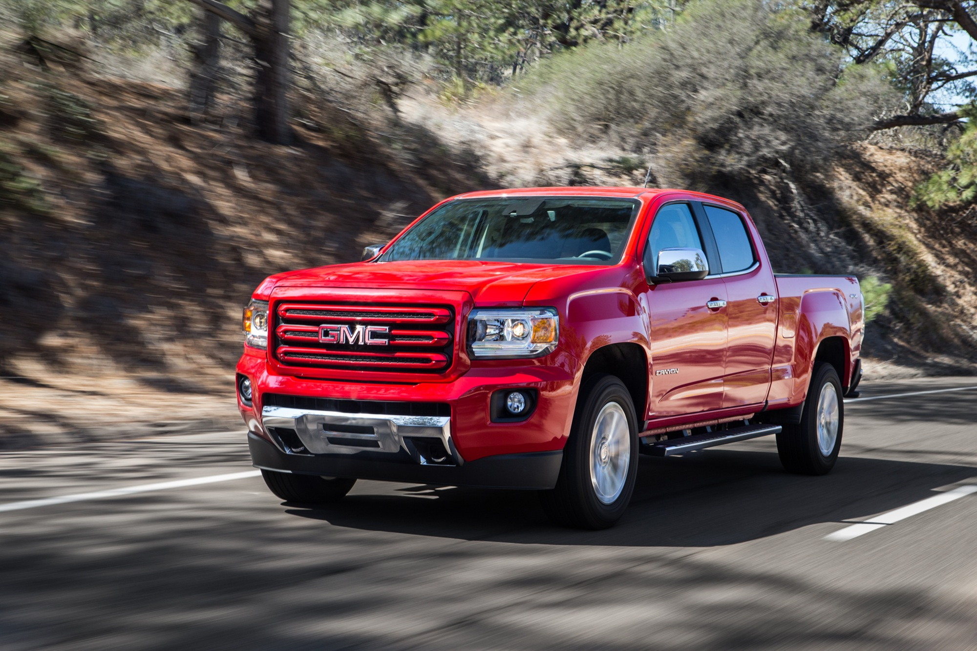
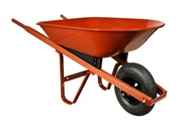
Key Advertising Categories
Businesses/products/services plan to visit/shop for/purchase (next 12 months)
Michigan
Adults (#)
Newspaper
Readers
Non-Newspaper
Readers
Appliances 2,415,000 33% 12%
Automobiles, trucks, SUVs 2.048,000 28% 15%
Banking/financial services 3,581,100 46% 38%
Boats and RVs 360,000 4% 5%
Drug stores 4,843,000 63% 46%
Educational opportunities 1,001,000 13% 9%
Electronic equipment 3,185,300 43% 23%
Groceries 6,985,000 89% 80%
Gyms/health clubs 1,527,100 21% 8%
Home furnishings (furniture, rugs, mattresses, etc.) 2,831,000 38% 22%
Home improvement products/services 2,884,400 39% 19%
Home services (pest control, HVAC, cleaning, etc.) 1,614,000 22% 11%
Jewelry/Watches 1,008,000 14% 3%
Liquor/wine/beer 3,041,000 40% 29%
Mobile phones/service 3,823,000 52% 27%
Outdoor farm/power equipment (rent or purchase) 1,847,000 25% 10%
Restaurants & bars 4,892,000 64% 47%
Sporting goods 1,687,000 22% 16%
TV service (cable, satellite, streaming, etc.) 3,639,000 47% 35%
Vehicle maintenance (tires, batteries, oil change, etc.) 4,224,000 55% 42%
Source: The Michigan State Study, 2023; Conducted by Coda Ventures Base: Total adults; multiple responses

Slide 50
Professional Services
Michigan
Adults (#)
Newspaper
Readers
Professional services planning to change/shop for (next/past 12 months)
Non-Newspaper
Readers
Auto insurance 1,991,000 25% 25%
Medical/health insurance 1,297,000 18% 8%
Home insurance 1,221,100 16% 9%
Dental insurance 1,163,000 15% 9%
Life insurance 1,037,000 14% 9%
Financial/investment service 822,000 11% 4%
Income tax provider 686,100 9% 7%
Mortgage/refinance service 542,000 7% 3%
Legal services 358,300 5% 2%
Source: The Michigan State Study, 2023; Conducted by Coda Ventures Base: Total adults; multiple responses

Slide 51
Medical Specialists
Medical specialists used by household (past 12 months) or plan to use (next 12 months)
Michigan
Adults (#)
Newspaper
Readers
Non-Newspaper
Readers
Dentist/orthodontist 5,025,000 64% 55%
Optometrist/ophthalmologist 3,039,000 39% 32%
Dermatologist/skin doctor 1,538,000 21% 9%
Physical therapist 1,314,300 18% 8%
Chiropractor 1,271,000 17% 10%
Hearing specialist/ENT 683,000 9% 8%
Orthopedist/sports medicine doctor 671,200 9% 7%
Source: The Michigan State Study, 2023; Conducted by Coda Ventures Base: Total adults; multiple responses

Slide 52
Turning Local Market Insights Into Ad Revenue for Your Newspaper

Slide 53
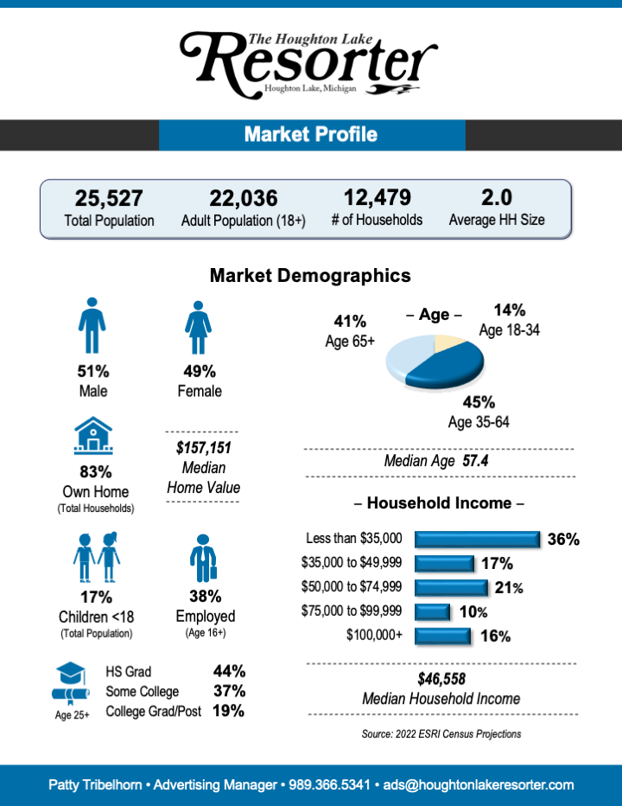
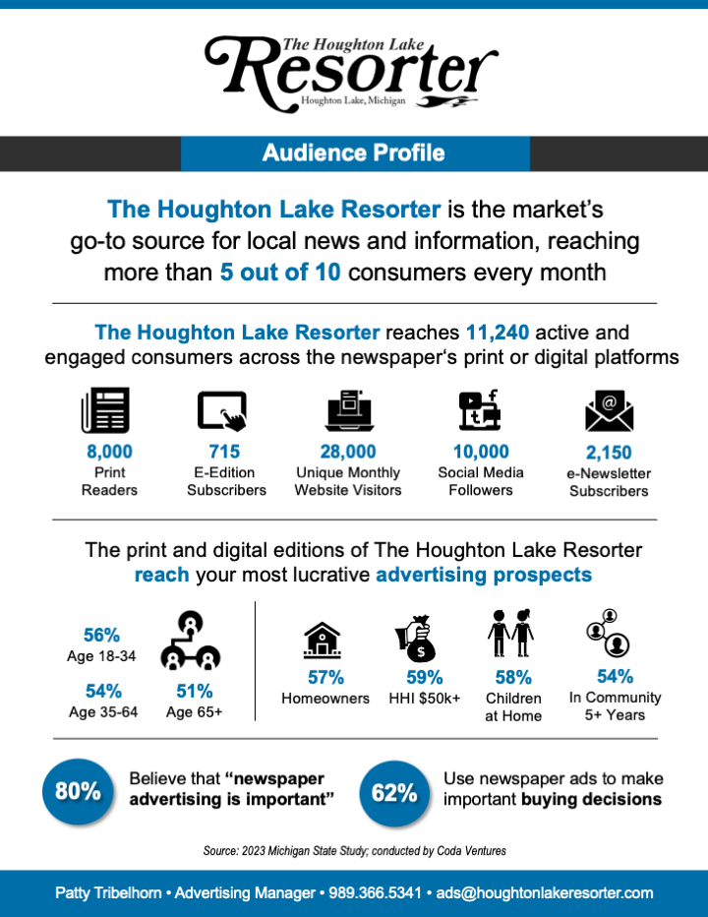
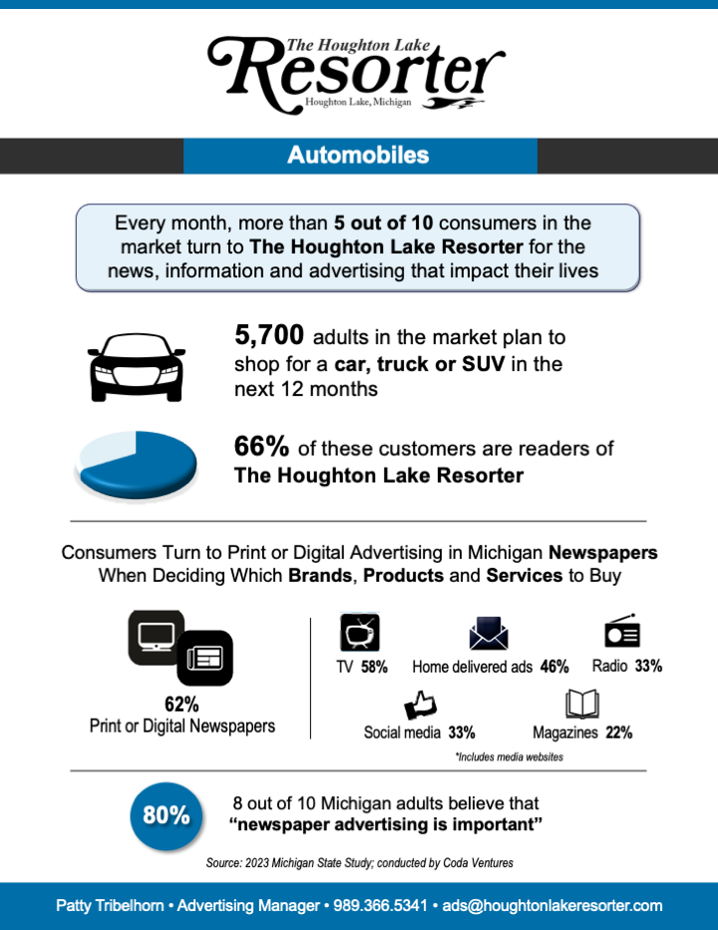
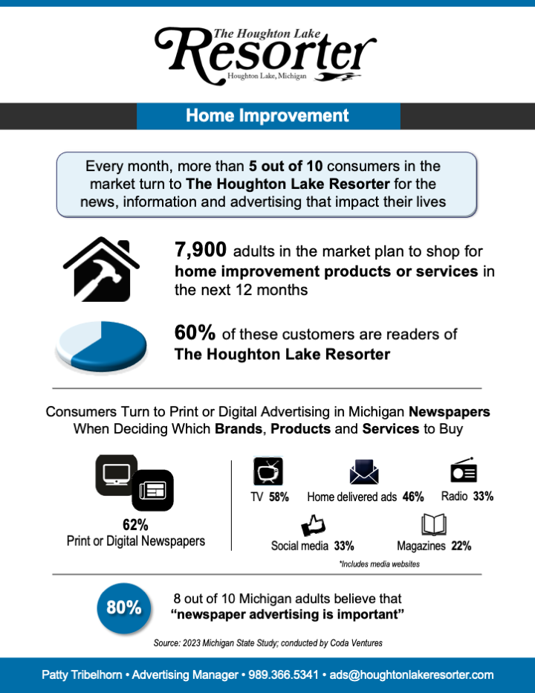
Custom Sales Sheets for MPA Members
Newspaper Sales Sheets
Market Profile
Audience Profile
Category Sales Sheets
(5 categories that you choose)

Slide 54
Custom Sales Sheets for MPA Members
Market Profile
Market size
Demographic composition

Slide 55
Custom Sales Sheets for MPA Members
Audience Profile
Total newspaper reach
Breakout of print and digital delivery channels
Target reach for key demos
Reliance and importance of newspaper advertising

Slide 56
Custom Sales Sheets for MPA Members
5 Category Sales Sheets
Individual category focus
Potential size of buyers
Targeted reach of prospects
Reliance and importance of newspaper advertising

Slide 57
Summary
Print and digital newspapers provide
broad reach of your local market
Newspaper readers are local opinion leaders and community influencers
Newspapers deliver active consumers
that advertisers want to reach
Newspaper readers like and expect to see newspaper ads… especially in print

Slide 58
Data-Driven Revenue
Marianne Grogan • Coda Ventures

