Slide 1
Rock Star Sales Panel
2019 MPA Annual Convention

Slide 2
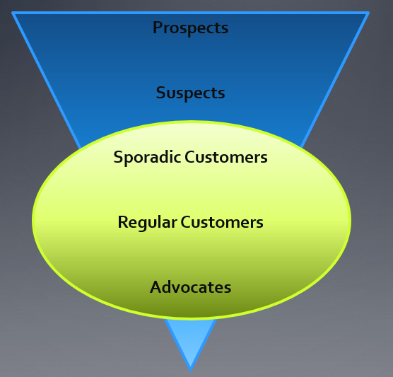
Getting out of the rut
Causes
Lost a big account
Budget decrease
Everyone saying no
Getting too comfortable
Personal life is out of sorts
Remedies
Review your account list to find some good suspects
Set aside 30 minutes everyday to prospect
Network
Make a list of your top deals in the past 3 months
Talk to a top client
Meditate

Slide 3
Training – it’s up to you to be the best
Freshen Your Skills and Keep Learning
Watch sales webinars
Tons of free resources online
Listen to a pod cast
Ryan Dorn 360 selling - http://360adsales.com/
Sales Hacker - https://www.saleshacker.com/best-sales-podcasts/
Motivational speakers – Zig Zigler, Tony Robbins, Brian Tracy
Read a book
Smart Selling on the phone and online – by Josaine Feigon
Survival Selling – Mike Blinder
The Difference Maker – John C. Maxwell
the ONE THING - The surprisingly simple truth behind extraordinary results - Gary Keller w/Jay Papasan

Slide 4
10 Secrets of top performing Sales Reps
Be a trusted advisor
Business partner vs. pushy sales person
Take time to build the relationship
Be confident and enthusiastic
A confident enthusiastic attitude is contagious
Reinvent sales approach
Mix up your elevator pitch or sales approach – clients are not one size fits all
Ask for the referral
Identify pain points and bring real solutions
Take a strategic sales approach - annual vs. ala carte, spec ads
https://valueandpricing.com/packages-and-bundles-vs-a-la-carte-pricing/
Know your book of business, where you are to goal and exactly what you need to do to hit goal
Network as much as possible
Communicate with customers at their comfort level not yours (email, text, phone, etc)
Set goals for weekly appts and keep them

Slide 5
Managing your Book of Business
Work “Smarter” – Not Harder
S: Specific (Be specific on what your goal is, along with when you want to achieve that goal. Describe exactly what you want to accomplish)
M: Measureable (make sure the goal is measurable so you’ll know when you have or have not accomplished it. Just like a business that advertises with you, how does a business measure if the ad worked or not? What results are you expecting and how will you measure the results to assure you actually reached your goal? )
A: Action (what actions are needed in order to achieve your goal? List all of the actions you can possibly think of, that will have to take place, in order for you to achieve your goal.
R: Realistic (make sure you are thinking BIG, but not too BIG. Make sure you have to STRETCH for it, but that your goal is still Realistic, Reasonable and Achievable, if your goal is not realistic, lower the goal a bit, but remember, this IS a goal of IMPROVEMENT not status quo.)
T: Time Table (Get a calendar, mark the dates each action has to be accomplished in order for to you to reach your overall goal. Keep the Timetable/Calendar handy & VISIBLE. Give yourself just a bit of lee-way, so you are not “strapped or panicked” by the dates. That said, do your very best to complete the actions by the date specified on your calendar. )

Slide 6
Keeping and Establishing the Relationship
Question of the day – Is it better to have a good relationship with the client or a high performing campaign?
Understand your clients – find something relatable
Perform a needs assessment (discovery meeting) to make sure you know their pains and how to fix them
Ask questions – clients love to talk about themselves and their business
Speak the client’s language – don’t overwhelm them with industry jargon. Learn their industry lingo
Add Value – send them industry news and articles (birth announcements, obits)
Wish them Happy Birthday, know their children’s/spouse names
Schedule quarterly reviews
Ask them on a scale of 1-10 how likely they are to recommend your services
Utilize social media - just remember they see you too!
Take a client to lunch or for drinks

Slide 7
Additional resources
SOURCE | COMMENTS
Linked In & LinkedIn User Groups | Free. Take advantage of your professional network by posting each opening to your LinkedIn profile. Join User Groups to grow your reach. Use the search function to find candidates in your network that meet your criteria.
Social Media sites (Facebook, Twitter, etc.) | Free. Get the word out about your opening to everyone in your social network.
Alumni group postings | Free. Post jobs and network within your college or university alumni group.
Career Builder | Free. Leading job board; Gannett is majority owner. NOTE: All external job postings in Success Factors Recruiting should also be posted on CareerBuilder.
Craigslist | Free, except in select cities. Job posting site for all types of jobs
TwitJobSearch | Free. Job search engine for Twitter. Create the perfect job tweet quickly and easily.
The Career Place | Free. The Career Place posts open jobs on the National Labor Exchange database and on the Massachusetts One-Stop Career Center database.
Media Bistro | Paid. Destination job board for the best media talent. Featured Employer, Featured Job, and Job/Candidate Matching services available.
Media Post | Paid. Job posting purchase includes MediaPost Classifieds e-Newsletter to reach passive jobseekers.
Advertising Age Talent Works | Paid. Job posting and resume search available.
American Marketing Association (MarketingPower.com) | Paid. Job posting and resume search available.
Digital Media Wire | Paid. Reach an exclusive audience of senior level decision makers in digital entertainment and media industry. Can purchase web only or add e-newsletter.
paidContent.org | Paid. Job board with primary focus on business jobs in the digital media sector, promoted throughout their network of sites and newsletters.
SmartBrief | Paid. Job postings appear on industry-specific niche e-newsletters targeting a highly desired audience of passive and active jobseekers.
Online News Association | Paid. Nonprofit membership organization for digital journalists, connecting journalism, technology and innovation. Must be a member of ONA to post jobs.
Cynopsis Media | Paid. Cynopsis: Digital is a must-read for people in content, distribution, technology, ad sales and creative services. Job postings appear on targeted e-newsletters and websites.
JournalismJobs.com | Paid (Inexpensive). JournalismJobs.com is the largest and most-visited resource for journalism jobs, including media sales.
EditorandPublisher.com | Paid (Inexpensive). Editor & Publisher is the authoritative journal covering all aspects of the newspaper industry, including business, newsroom, advertising, circulation, marketing, technology, online and syndicates.
CTIA (The Wireless Association) | Paid. The wireless industry's exclusive resource for online employment connections
Spots and Dots | Paid. Job board targets broadcast professionals, including sales.
John Kelly’s Daily Clips | Paid. Daily newsletter with media news and job listings.
Local Sites | Any additional local job boards in your area.

